Slide 1

Fabrication of graphitic-carbon suspended nanowires through mechano-electrospinning of photocrosslinkable polymers
A Osamu Katagiri Tanaka A01212611@itesm.mx
08 Apr 2020

Slide 2
Motivation & Problem Statement

Slide 3
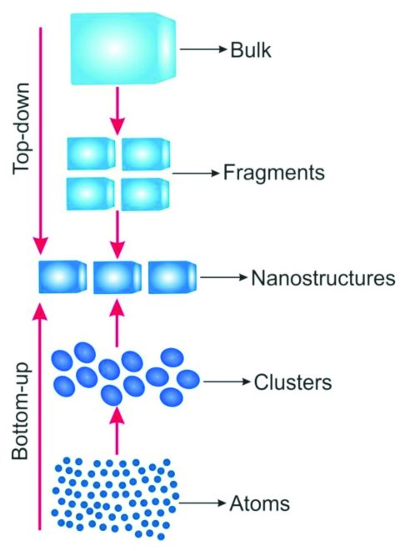
Current approaches for the fabrication of carbon nanowires (CNWs)
Lithography
Physical & Optical Limitations
Near-Field Electrospinning (NFES)
Can fabricate Suspended Nanowires w/Spatial Control
Self-assembly
Limited Length and Random Orientation
Two-Photon Polymerization (TPP)
Slow (mm per sec) & Expensive
V. Galstyan, M. Bhandari, V. Sberveglieri, G. Sberveglieri, E. Comini, Metal Oxide Nanostructures in Food Applications: Quality Control and Packaging, Chemosensors. 6 (2018) 16. https://doi.org/10.3390/chemosensors6020016.
D. Kluge, J.C. Singer, B.R. Neugirg, J.W. Neubauer, H.-W. Schmidt, A. Fery, Top–down meets bottom–up: A comparison of the mechanical properties of melt electrospun and self-assembled 1,3,5-benzenetrisamide fibers, Polymer (Guildf). 53 (2012) 5754–5759. https://doi.org/10.1016/j.polymer.2012.10.016.

Slide 4
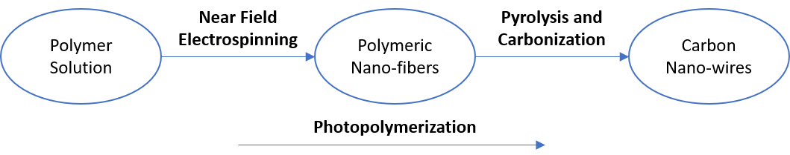
Thesis Overview
Design polymer solutions that can be electrospun by NFES, photopolymerized, and then pyrolyzed into conductive carbon nano-wires.

Slide 5
Polymer Solution Parameters

Slide 6
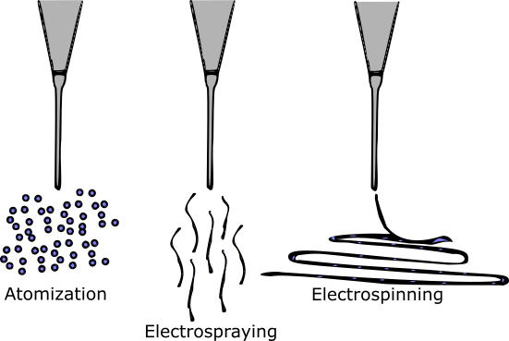
SU-8 Carbon Structures
The production of C-MEMS:
Polymer patterning through photolithography
Carbonization through pyrolysis
However, SU-8 as is can not electrospin
SU-8 does not have the right viscosity & solution conductivity
SU-8 is design for photolithography
Microchem, Su-8 2000.5-2015, 2000.5, 2002, 2005, 2007, 2010, 2015. (2006) 1–5. papers3://publication/uuid/859F51B9-0382-4DE8-88A9-267F936939A3.

Slide 7
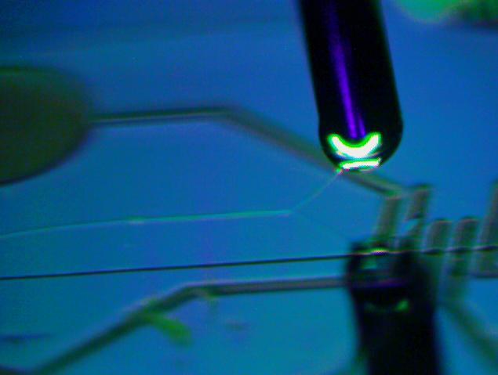
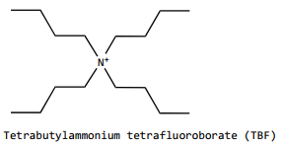
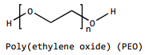
Making SU-8 spunable (by Braulio & Ricardo)
SU-8 + TBF + PEO
To increase the solution conductivity
To provided the required viscosity
… both needed for smooth PEO flow during electrospinning
B. Cárdenas, Advanced Manufacturing Techniques for the Fabrication and Surface Modification of Carbon Nanowires, (2017) 160.
D.R. Flores, Role of rheological properties in near field electrospun fibers morphology, (2017) 130.
Notes:
Surface t-

Slide 8
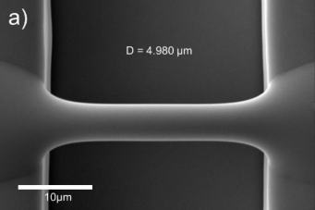
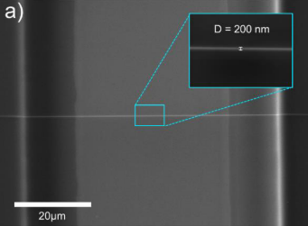
Results with amended SU-8
The modified solution is spunable
Fiber diameter before pyrolysis of 4.966 μm
Fiber diameter after pyrolysis of 204 nm
But, somewhat pyrolyzable
Fiber resistivity from 407 KΩ to 1.727 MΩ
Fiber yield rate of 81 %
Achieved with:
wt% PEO 0.25 | SU-8 2002 [mg] | PEO [mg] | TBT [mg]
 | 2246 | 5.65 | 11.32
= 2 ml of solution

Slide 9
Implications of PEO, as it introduces oxygen to the solution
The fiber yield rate and fiber conductivity are impacted negatively.
Some samples are destroyed during pyrolysis
High variance in the obtained conductivity across samples.
In the presence of oxygen, the char yield decreases. This is due to the oxidation on the char.
Notes:
Surface t-

Slide 10
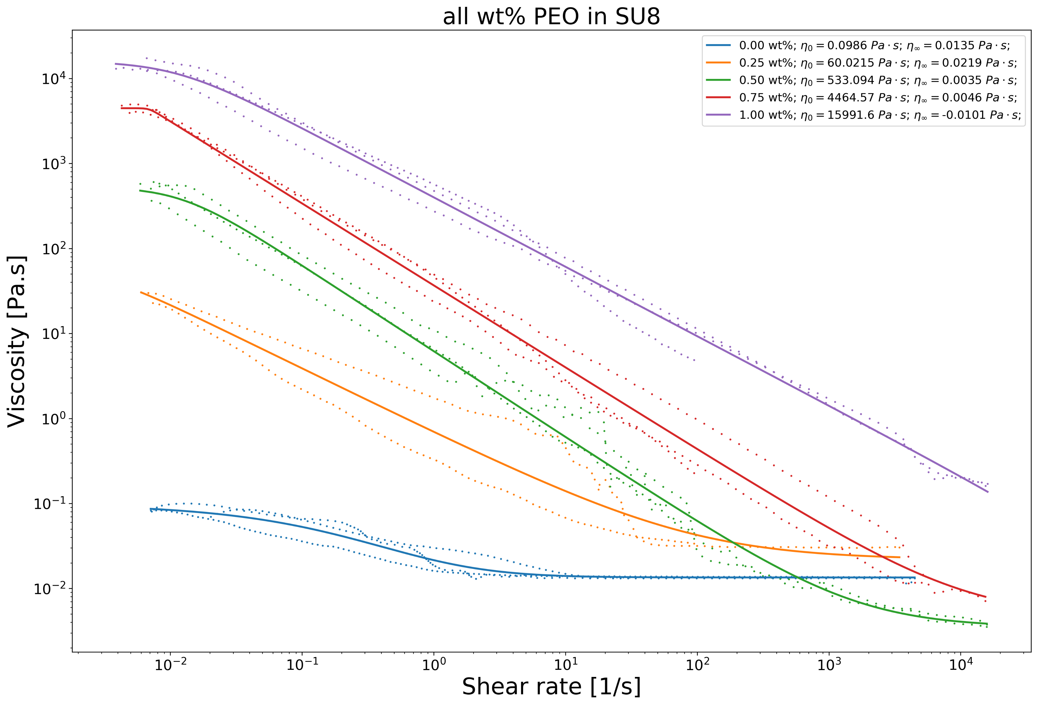
Rheology of the amended SU-8 solution (0.25 wt%)
The 0.25 wt% sample (orange line) has a zero-shear viscosity (ZSV) of 60 Pa.s
Let’s discover new polymer solutions with similar rheology (and no oxygen)

Slide 11
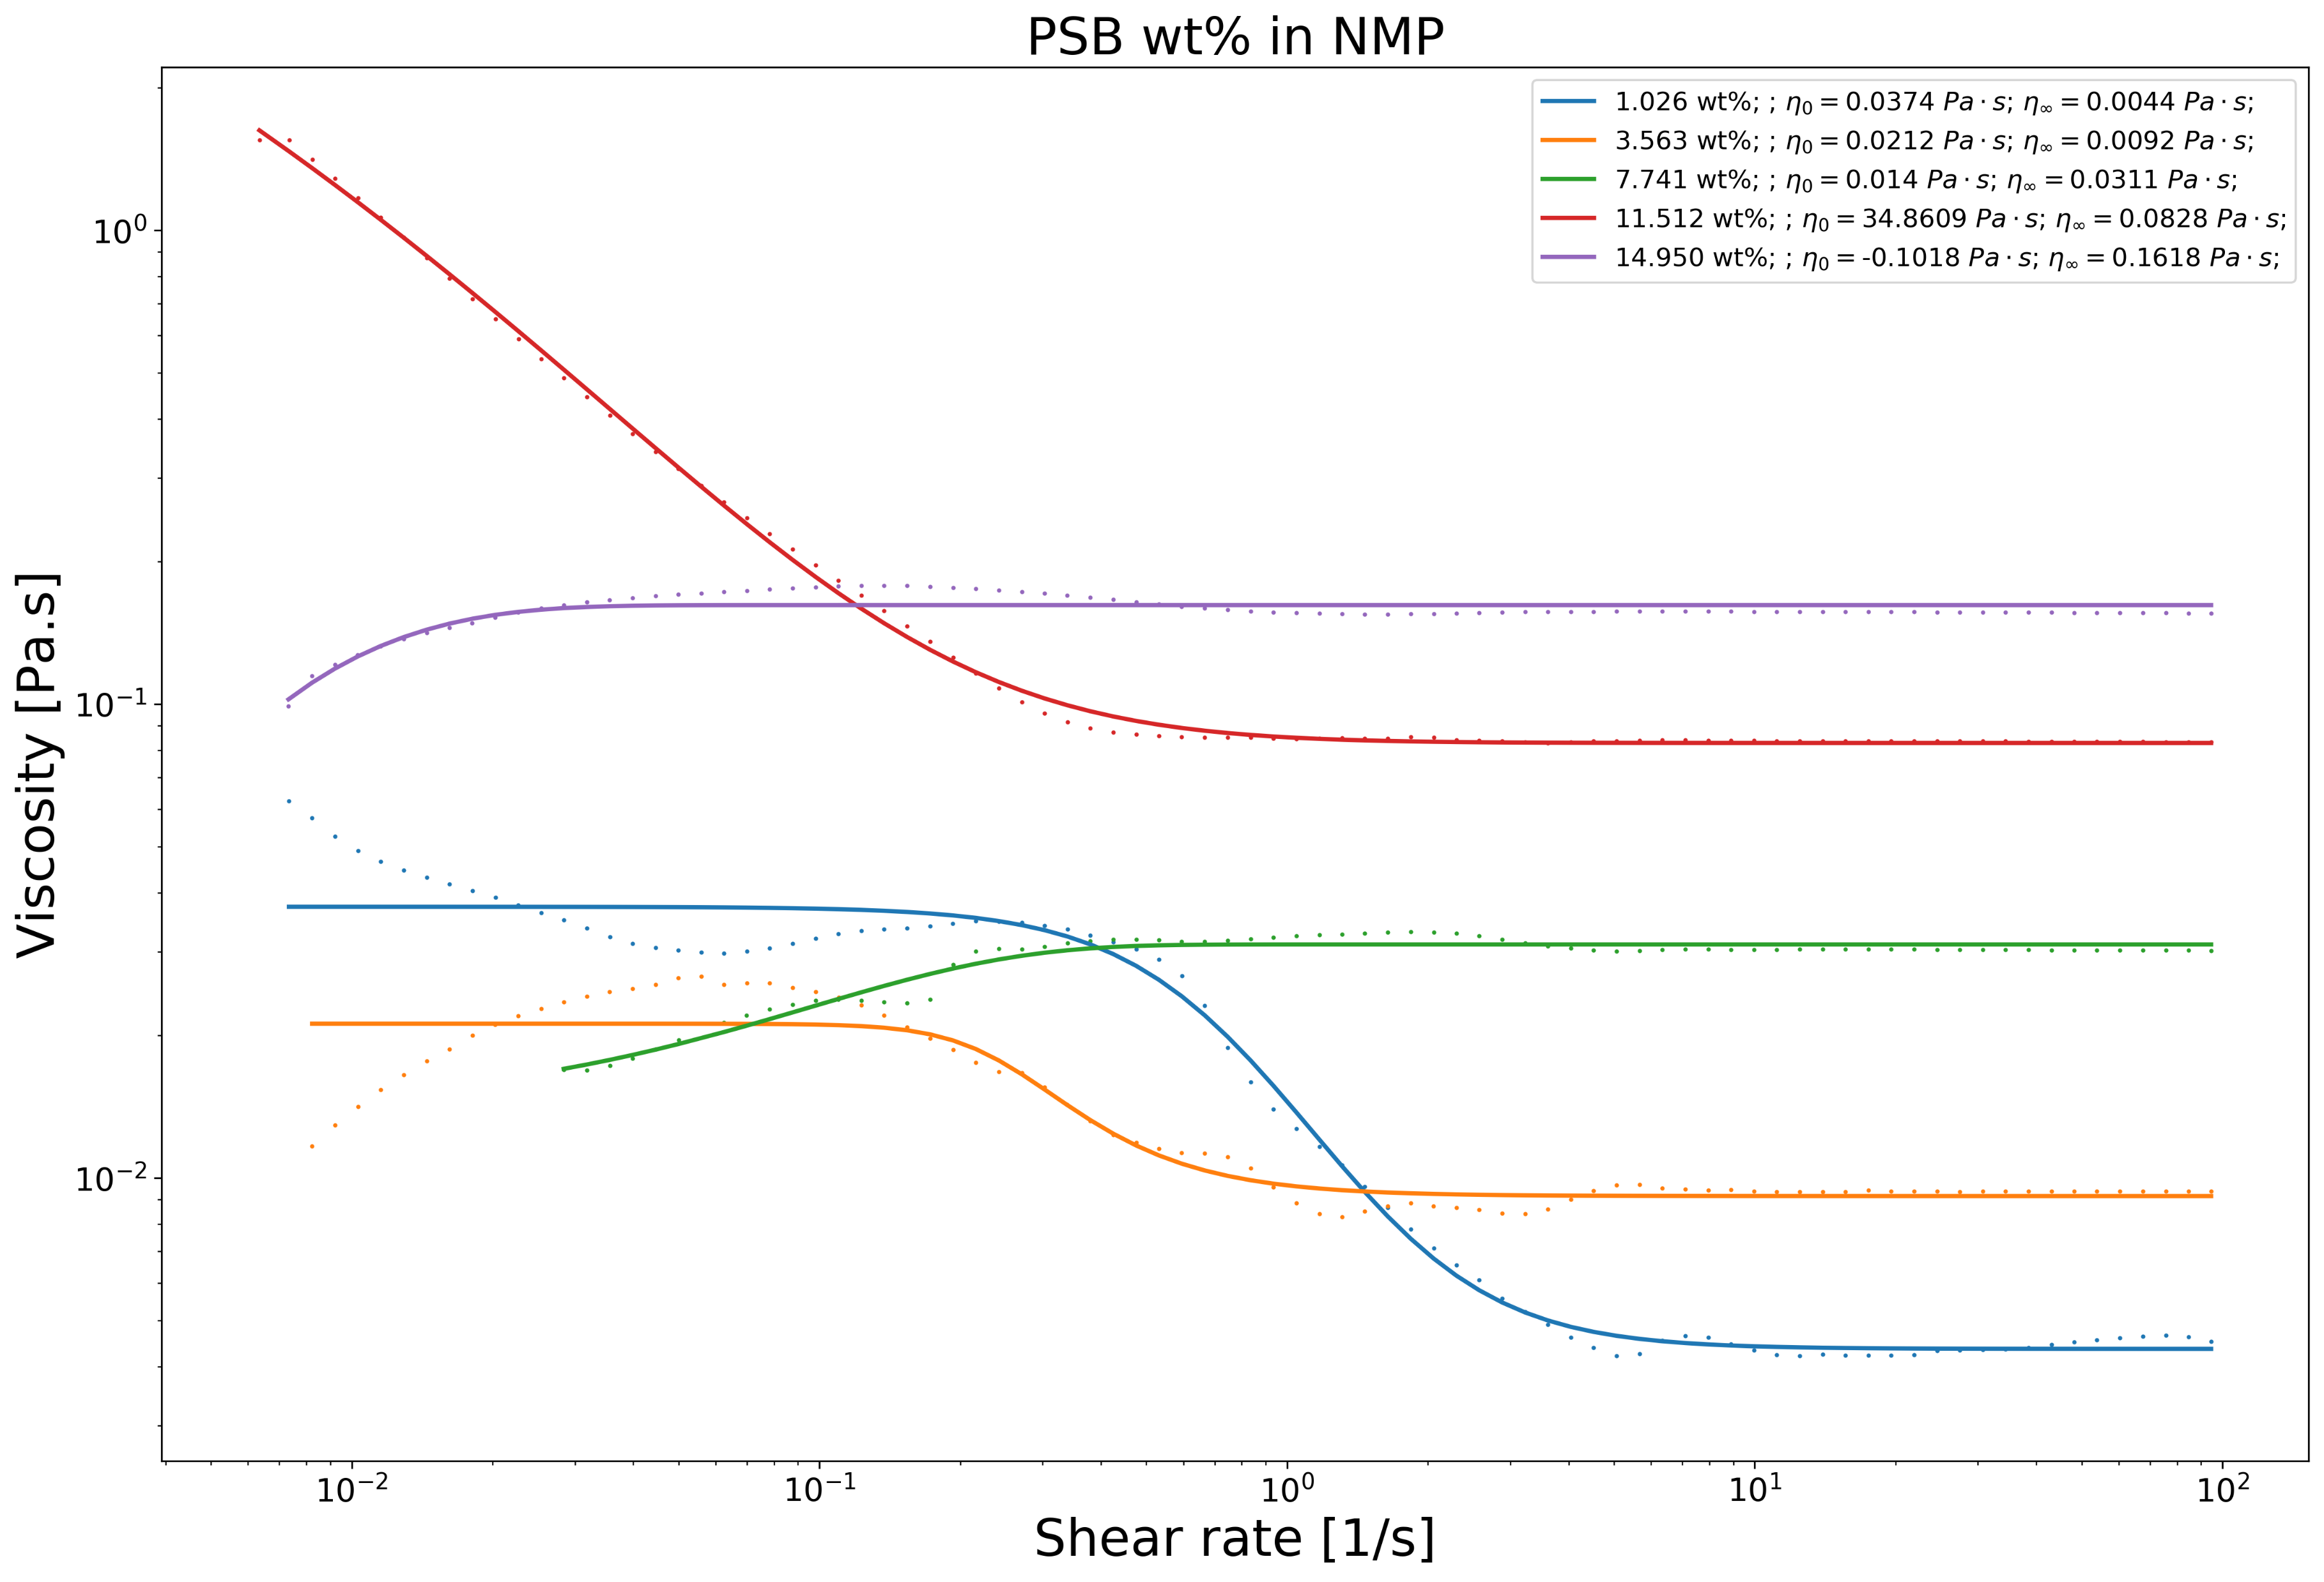
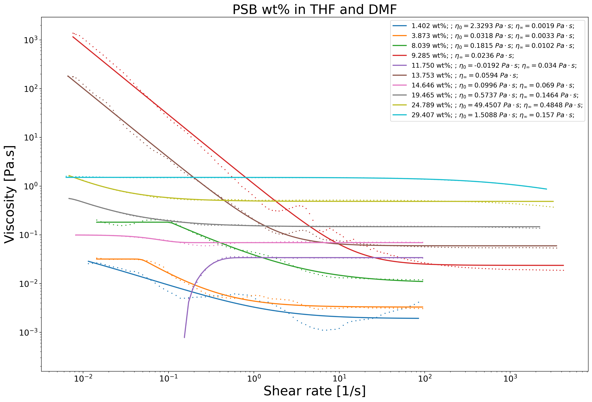
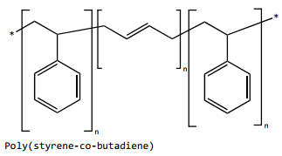
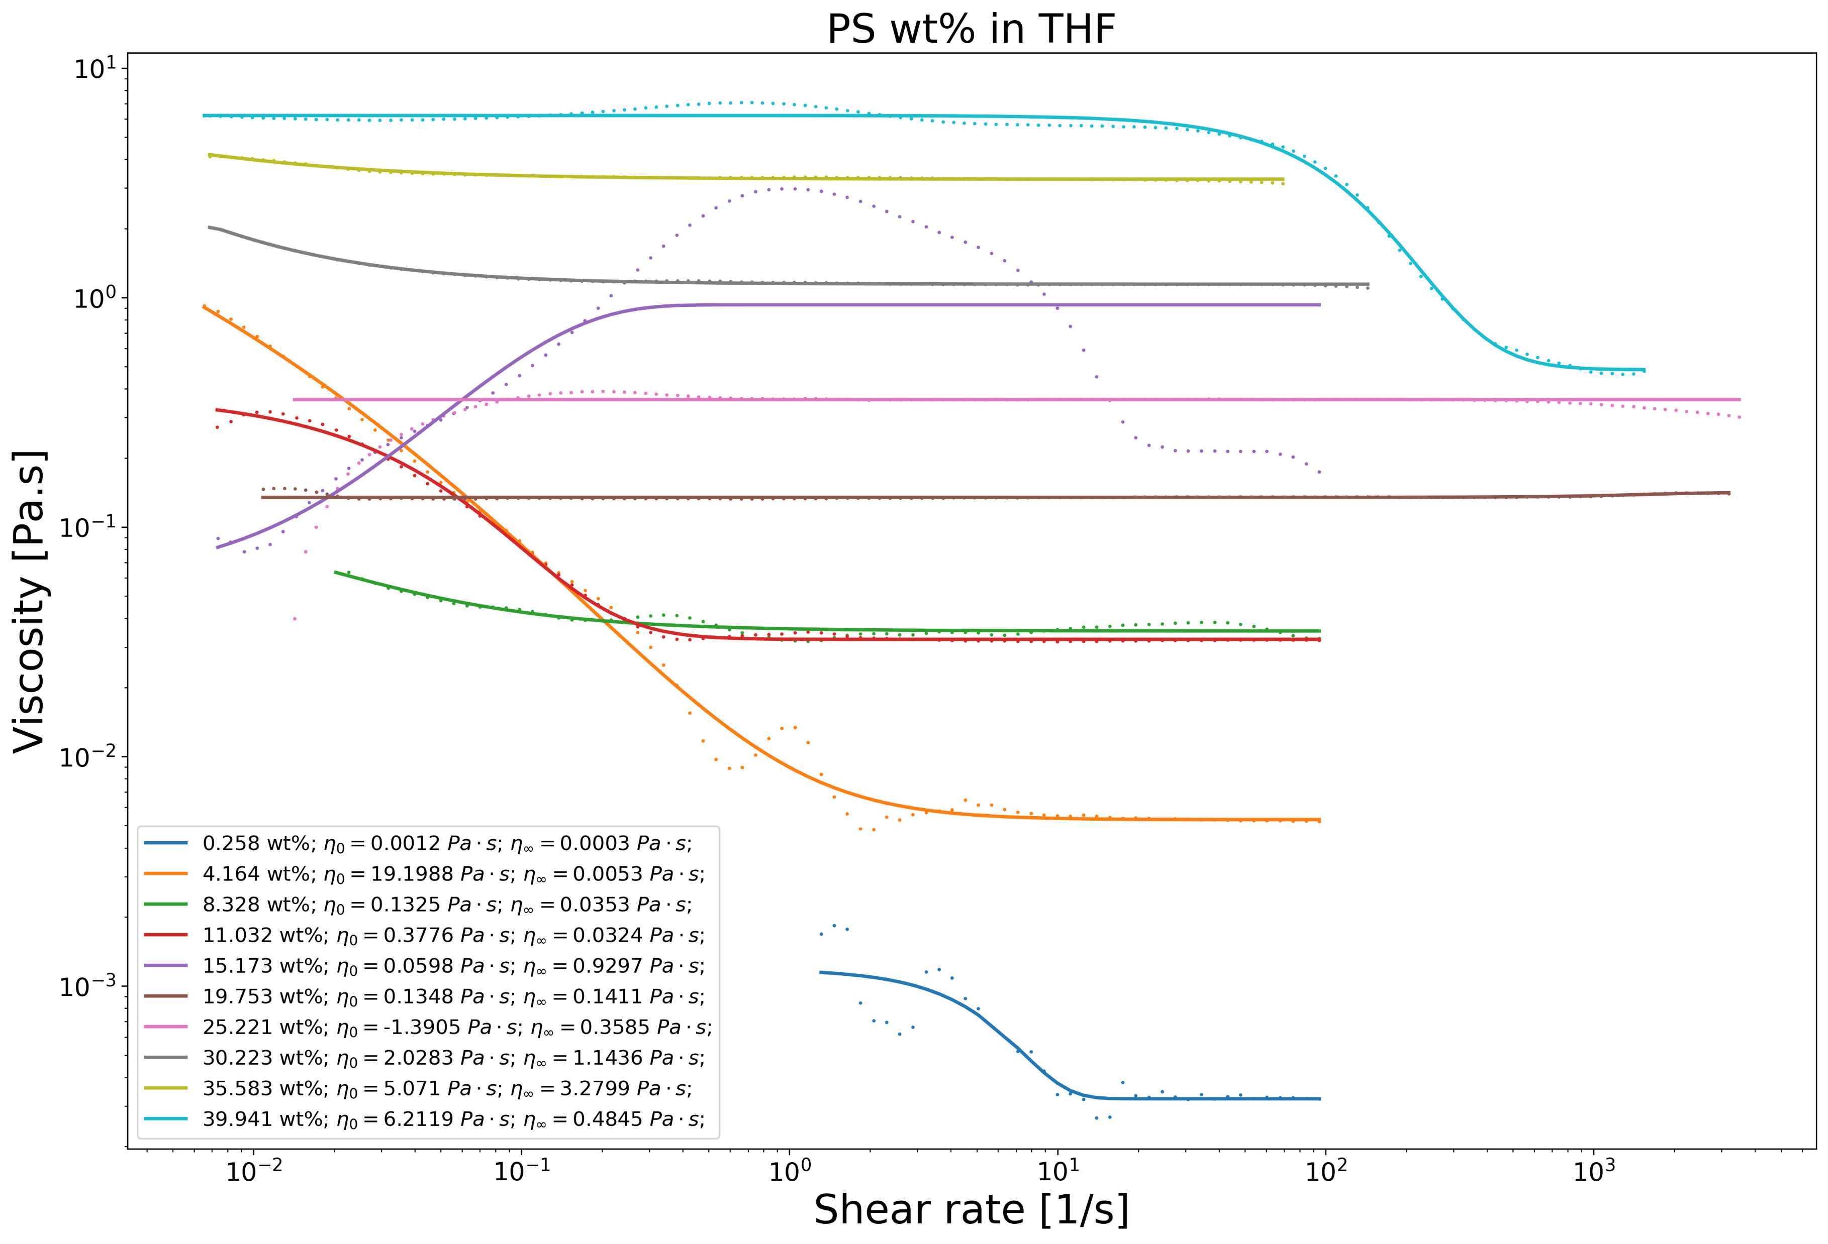
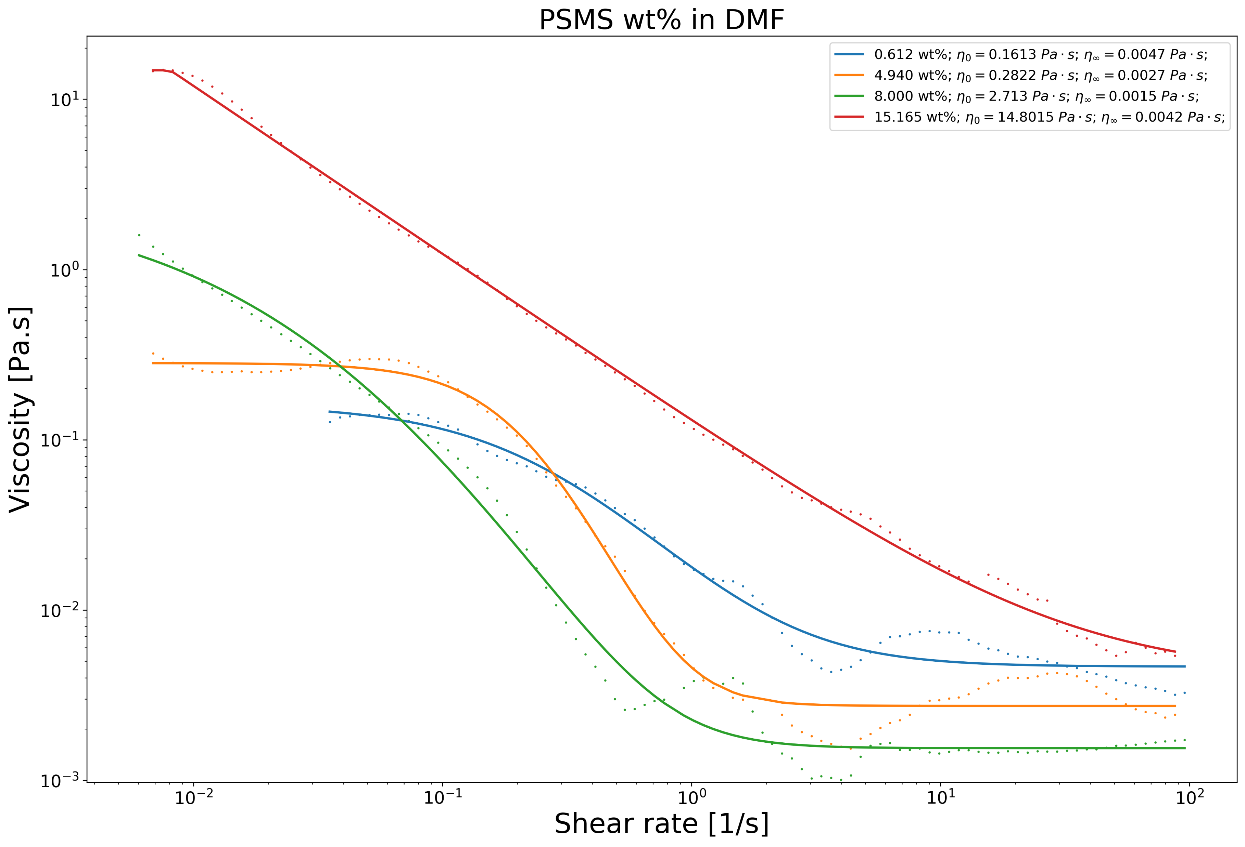
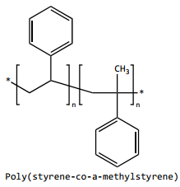
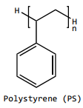
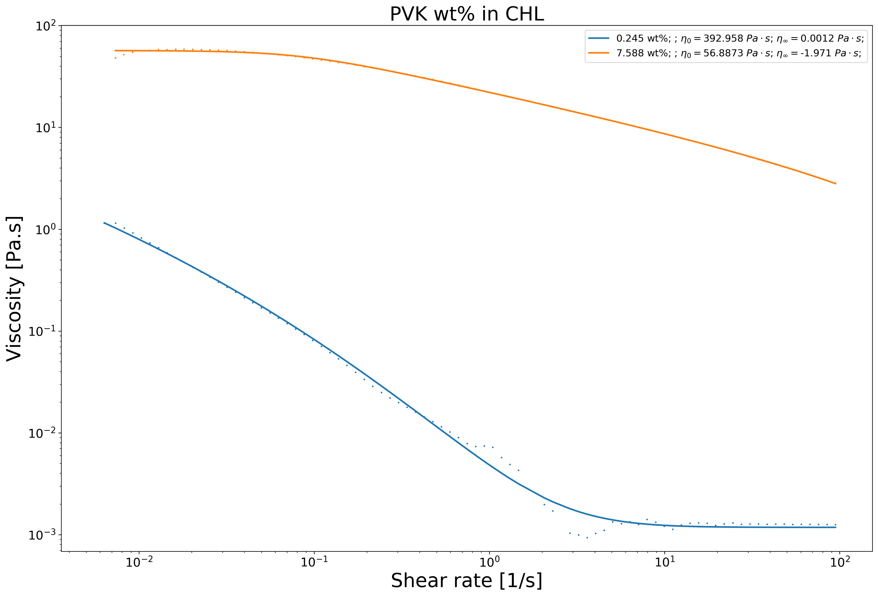
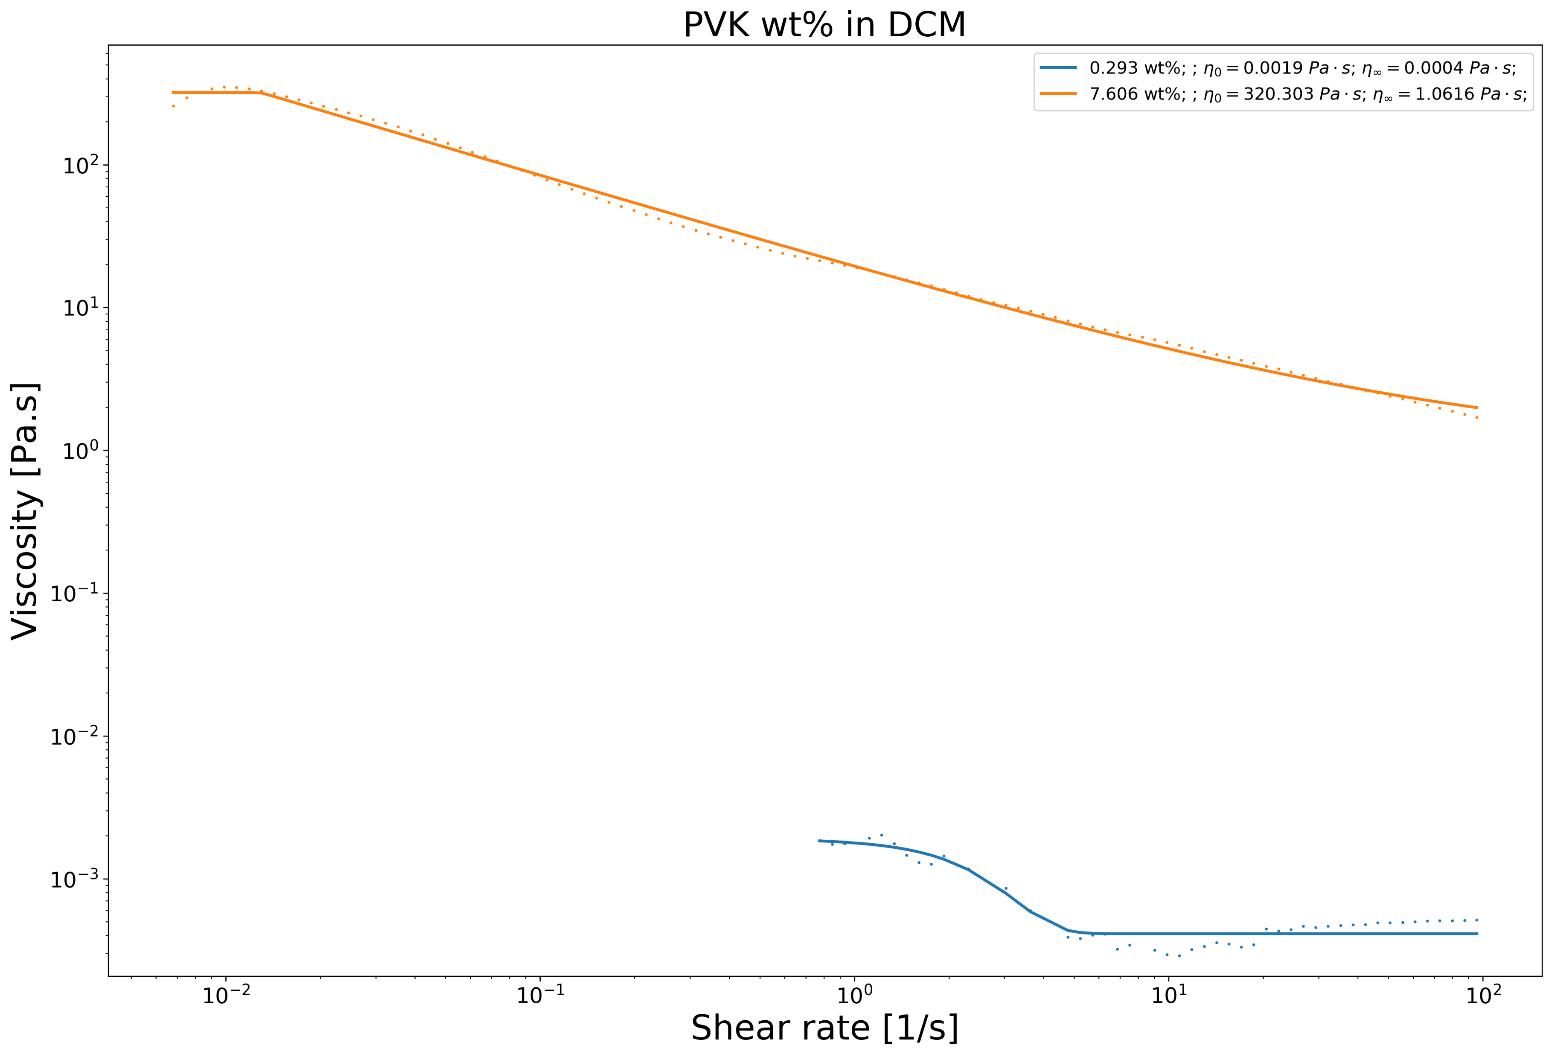
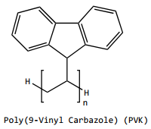
25 wt% in THF & DMF
15 wt% in NMP
15 wt% in DMF
35 wt% in THF
8 wt% in CHL
7 wt% in DCM

Slide 12
NFES Process Parameters

Slide 13
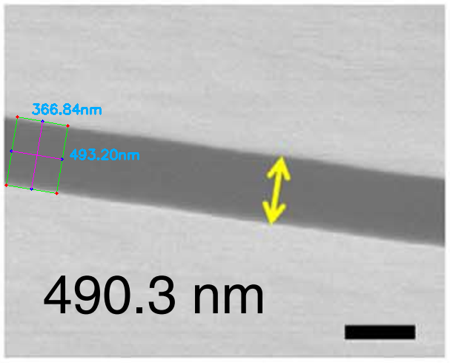
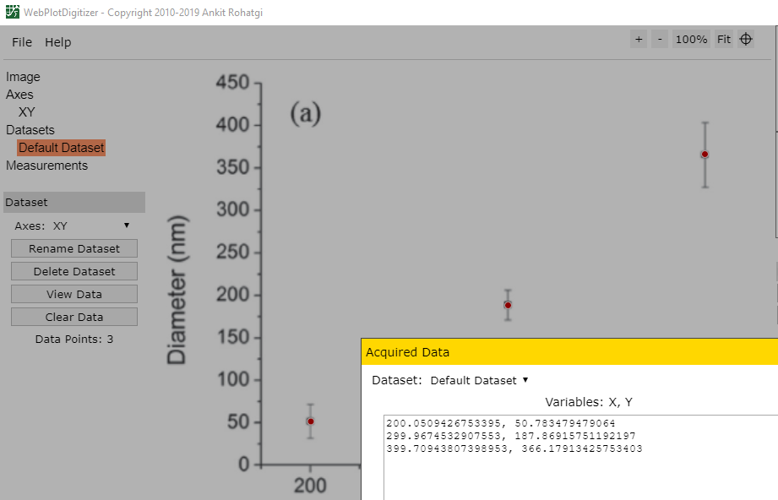
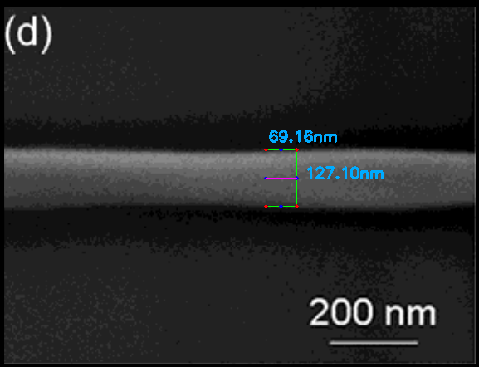
Data collection from 30+ NFES papers
Python Image Analysis
WebPlotDigitalizer https://github.com/ankitrohatgi/WebPlotDigitizer
Figure from Min2013
Applied voltage vs. fiber diameter by Madou2011
Figure from Camillo2013

Slide 14
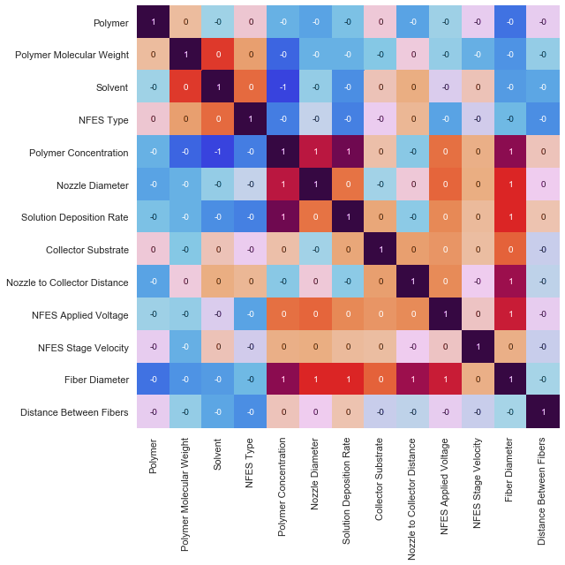
Polymer Concentration,
Nozzle Diameter,
Solution Deposition Rate,
Nozzle to Collector Distance &
Applied Voltage
are the main drivers of the final Fiber Diameter

Slide 15
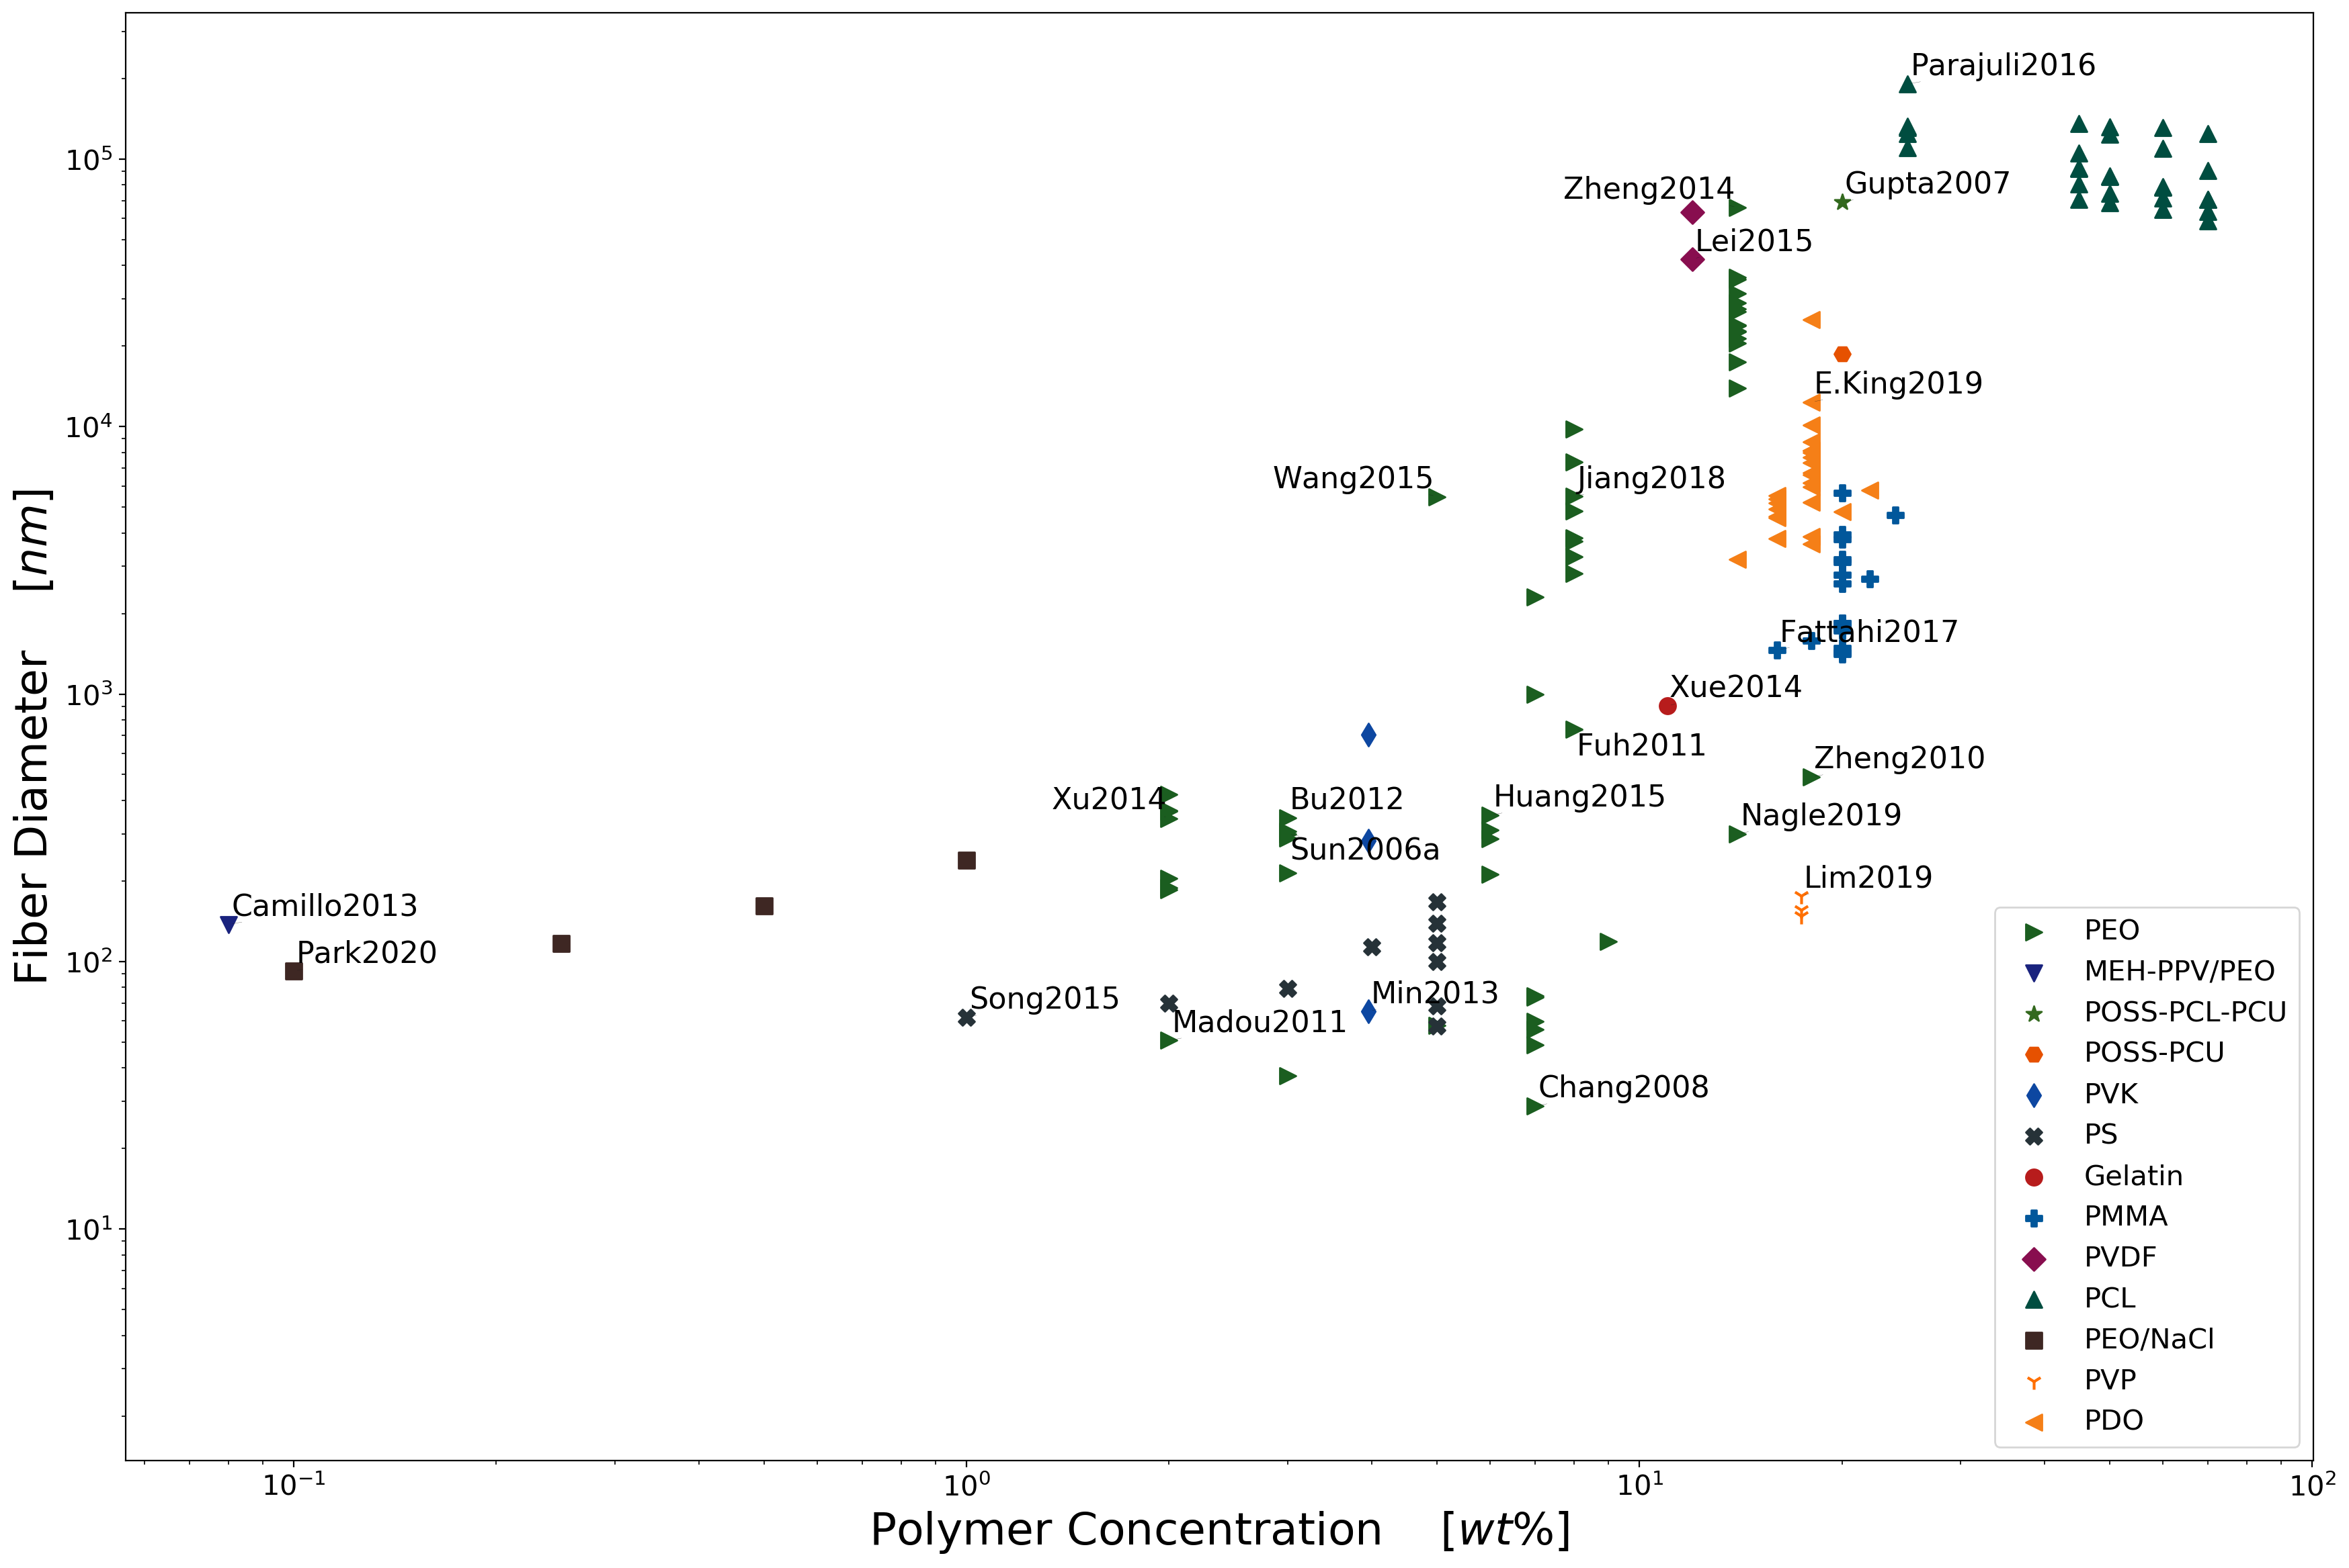
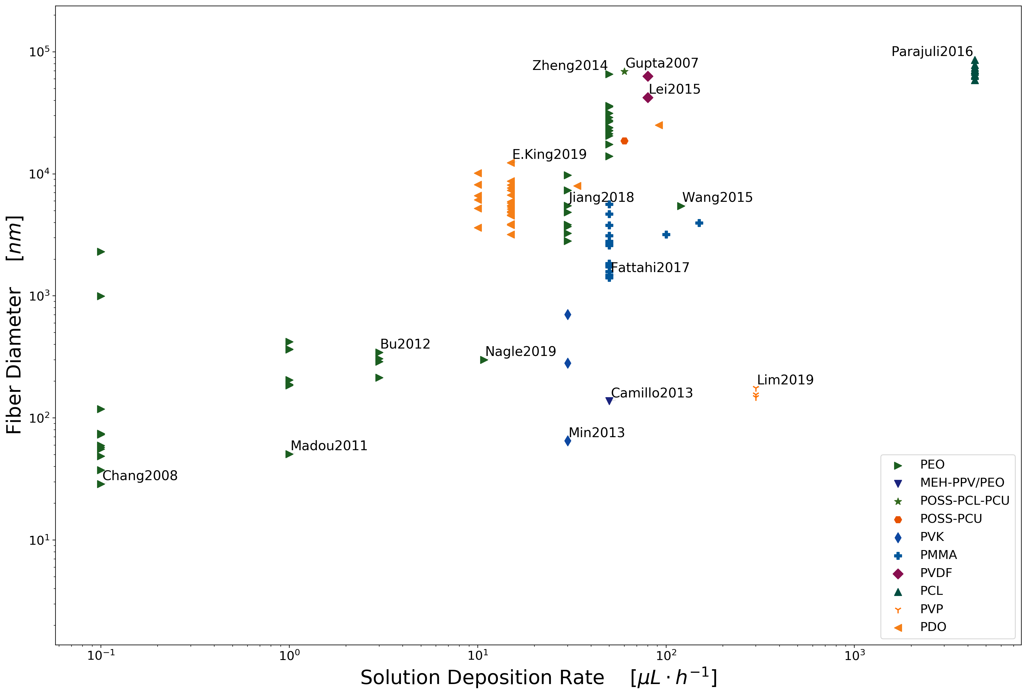
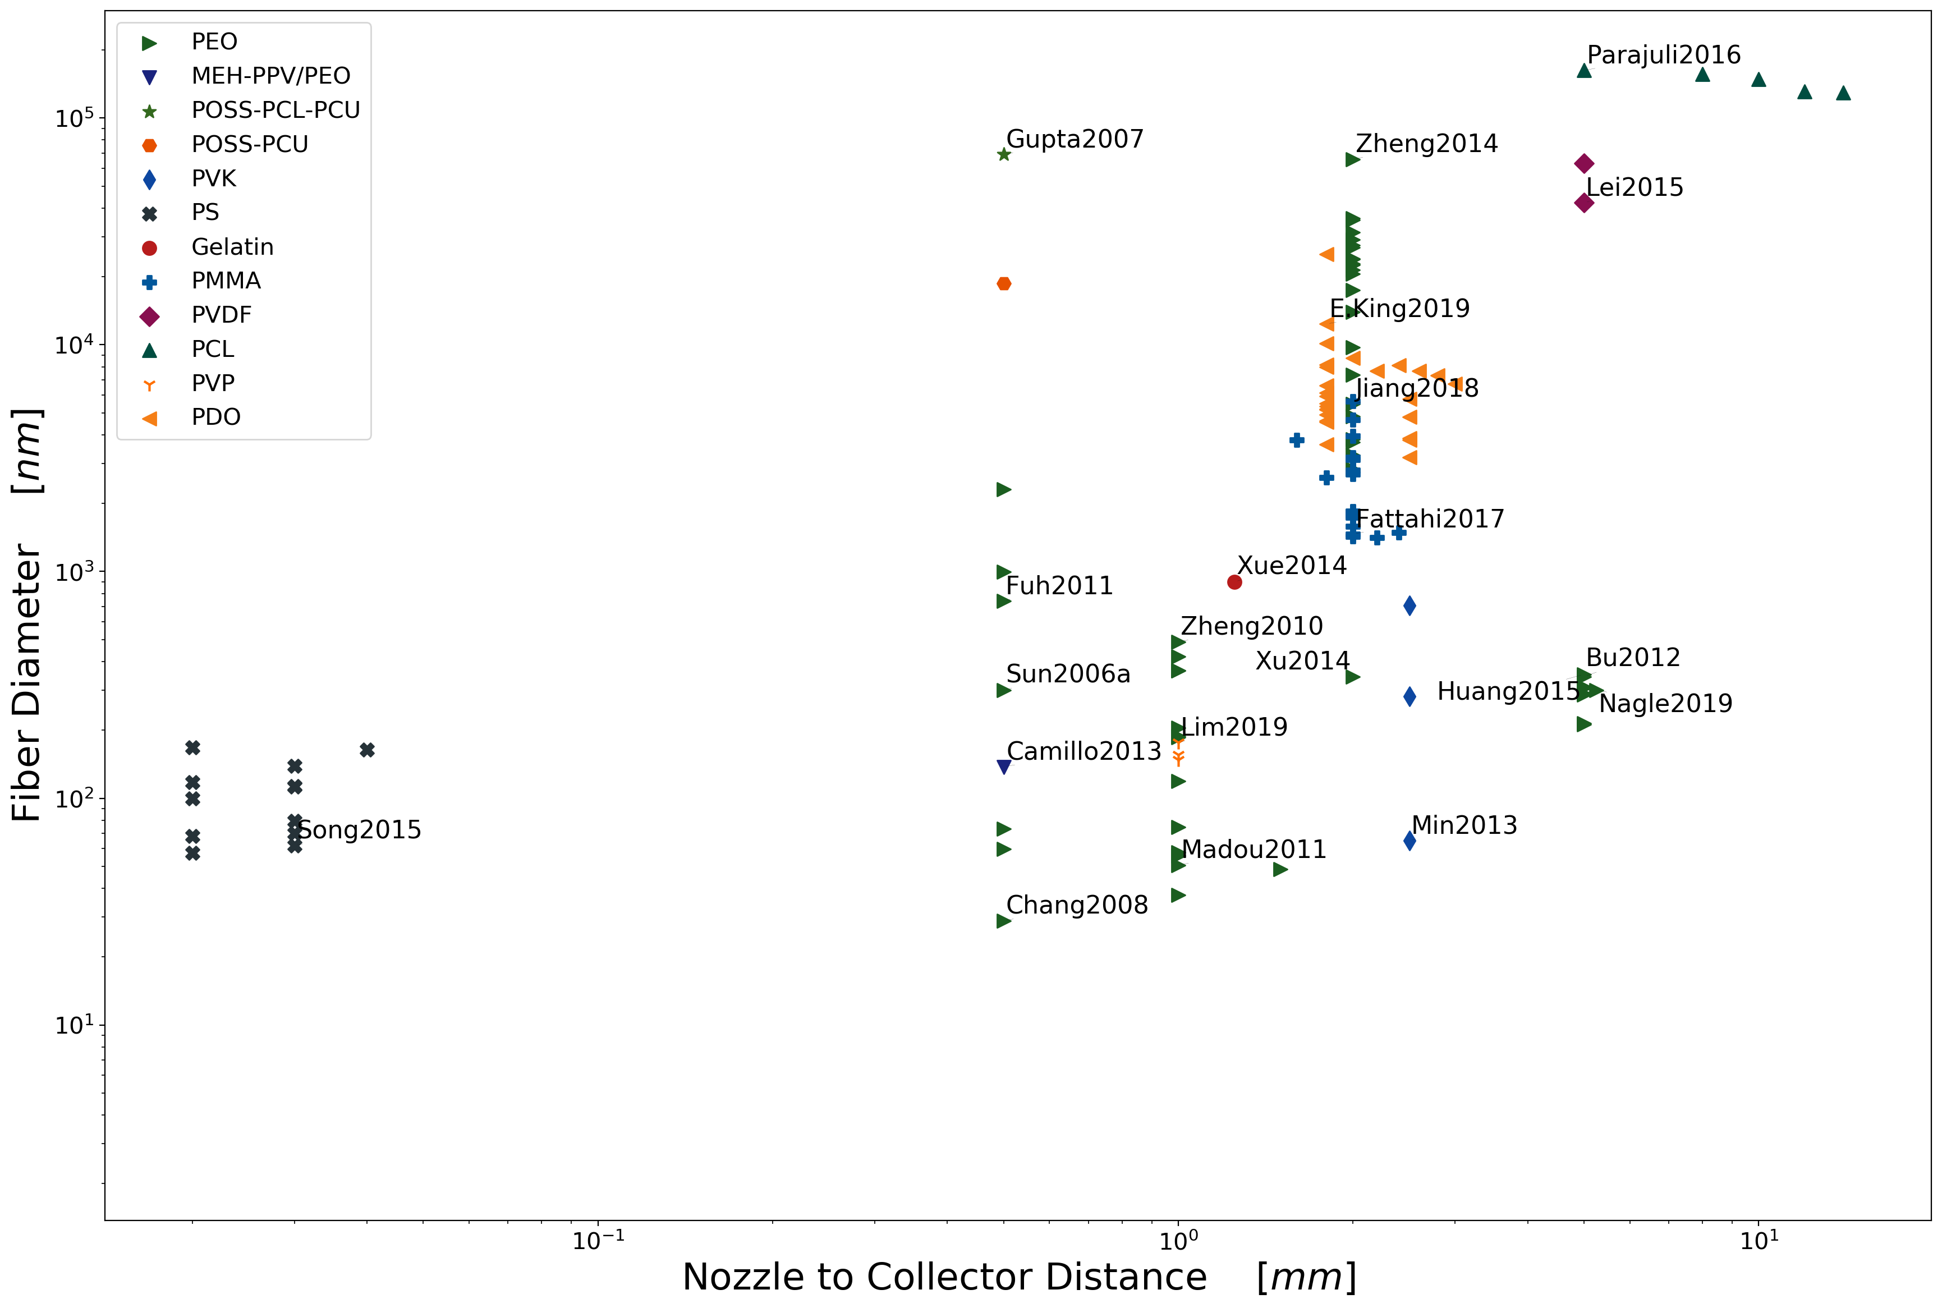
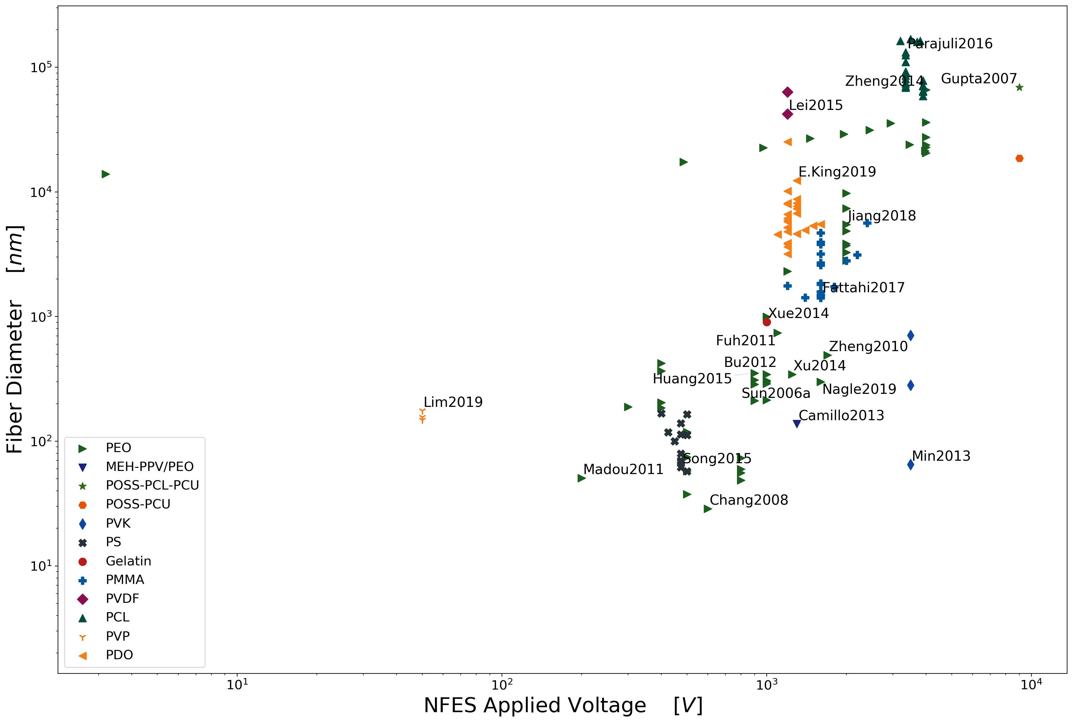
low polymer concentrations
slow solution deposition rates
low voltages
short nozzle to collector distances

Slide 16
Overall Progress & Next Steps

Slide 17
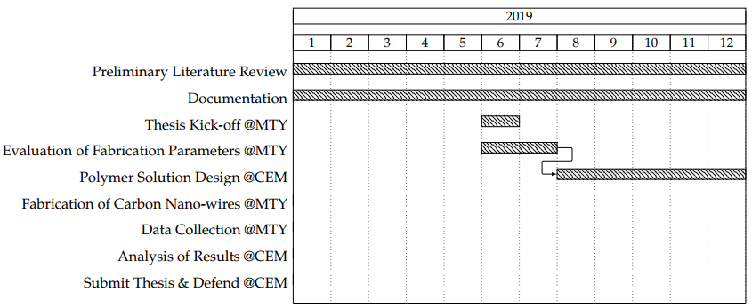
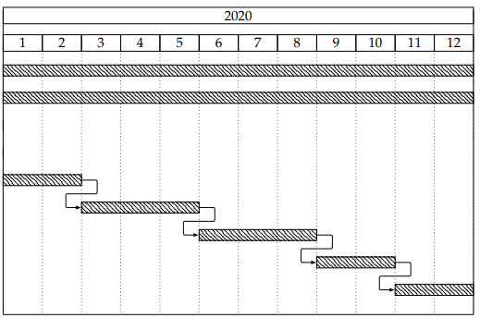
Current Work Plan
rheology
today

Slide 18
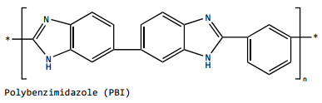
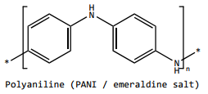
Next step: Study/Test the proposed polymer solutions
high carbon polymers and no oxygen
+15 wt% in DMF
~15 wt% in NMP
~25 wt% in THF & DMF
+35 wt% in THF
No records
No records
~8 wt% in CHL

Slide 19



Slide 20
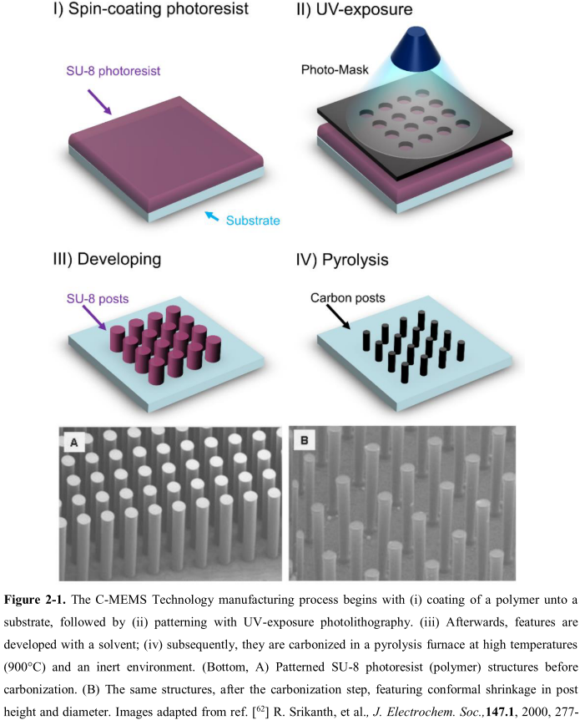
Carbon nanostructures via Lithography
The production of C-MEMS:
Polymer patterning through photolithography electrospinning
Carbonization through pyrolysis
● SU-8 Waste
● Physical & Optical Limitations
● Structure Limitations
photolithography process

Slide 21
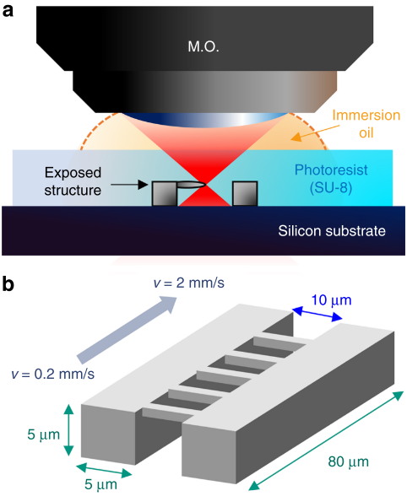
TPP – Two-Photon Polymerization
B. Cardenas-Benitez, C. Eschenbaum, D. Mager, J.G. Korvink, M.J. Madou, U. Lemmer, I. De Leon, S.O. Martinez-Chapa, Pyrolysis-induced shrinking of three-dimensional structures fabricated by two-photon polymerization: experiment and theoretical model, Microsystems Nanoeng. 5 (2019). https://doi.org/10.1038/s41378-019-0079-9.

Slide 22
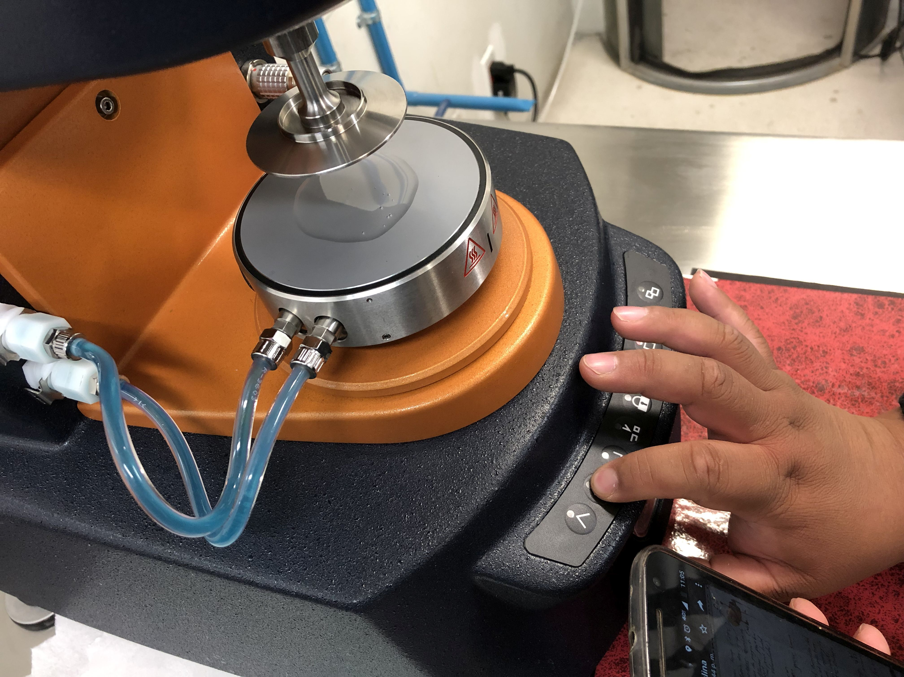
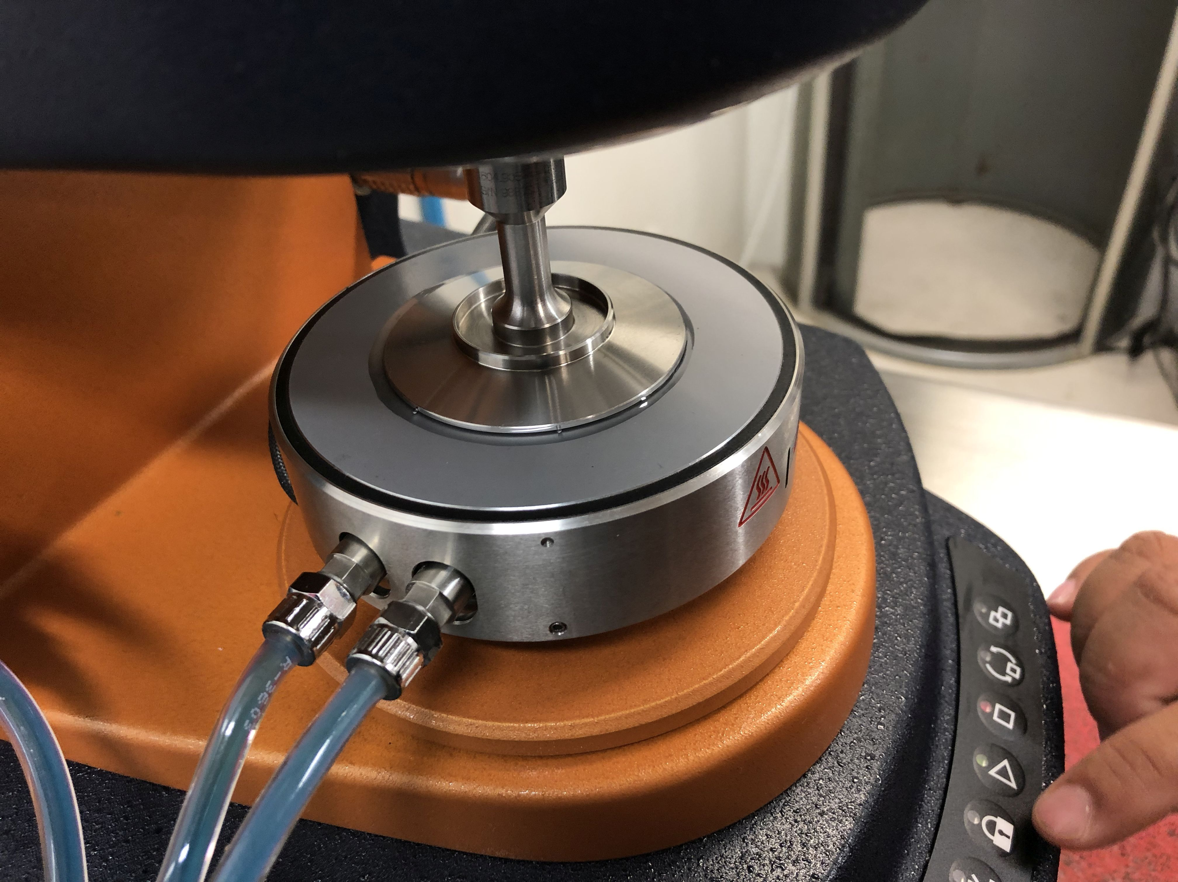
Characterization of the 0.25 wt% PEO Solution
Notes:
Surface t-

Slide 23
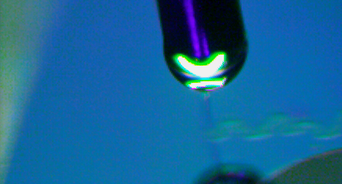
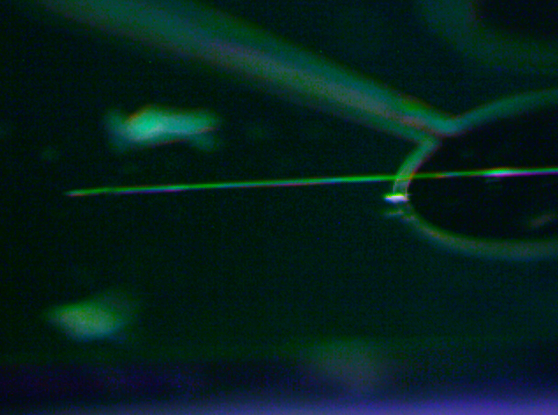
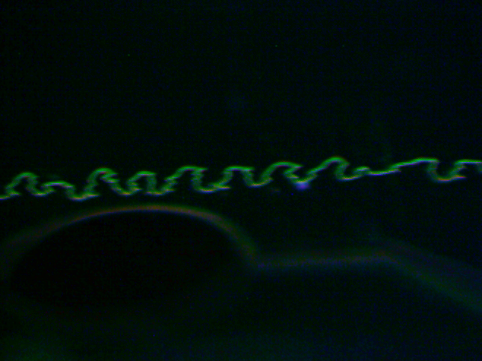
Characterization of the 0.25 wt% PEO Solution
Electrospun-able with an applied voltage of 600V.
Unable to initiate the jet at 500V or lower.
600V
700V
Notes:
Surface t-

Slide 24
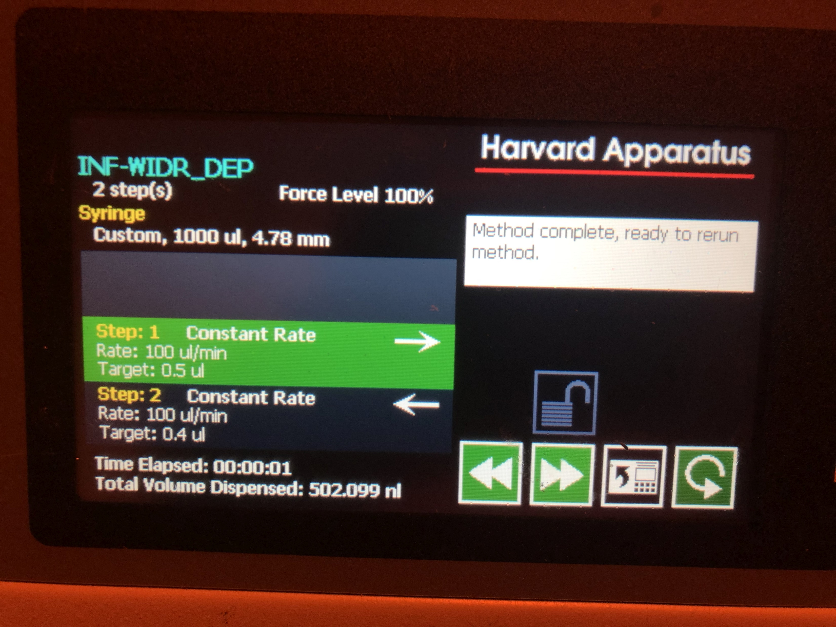
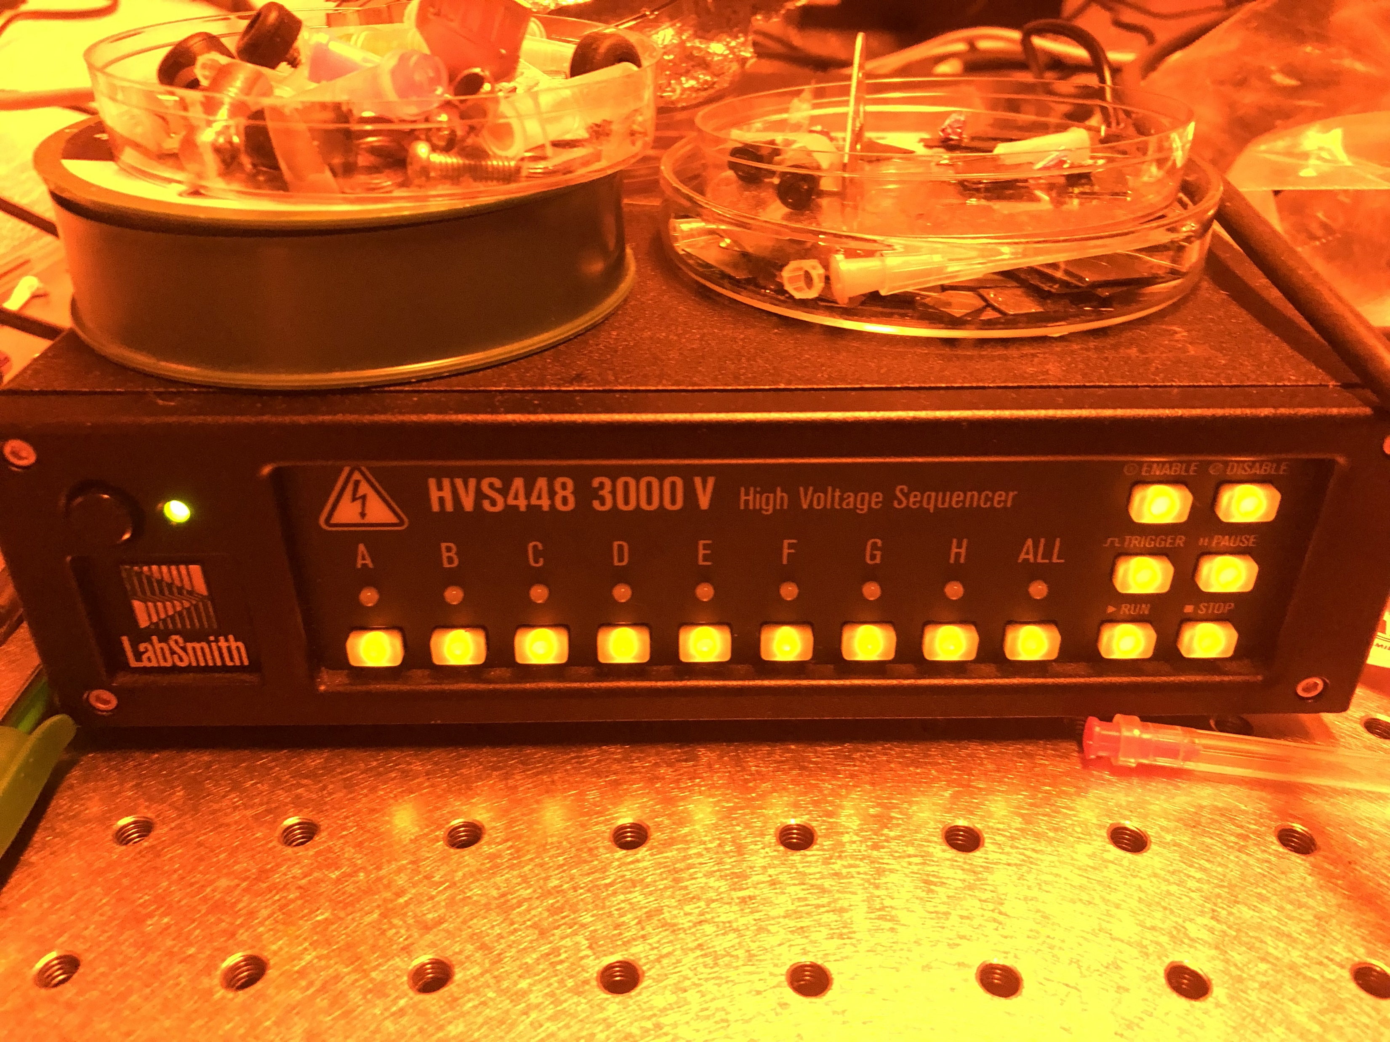
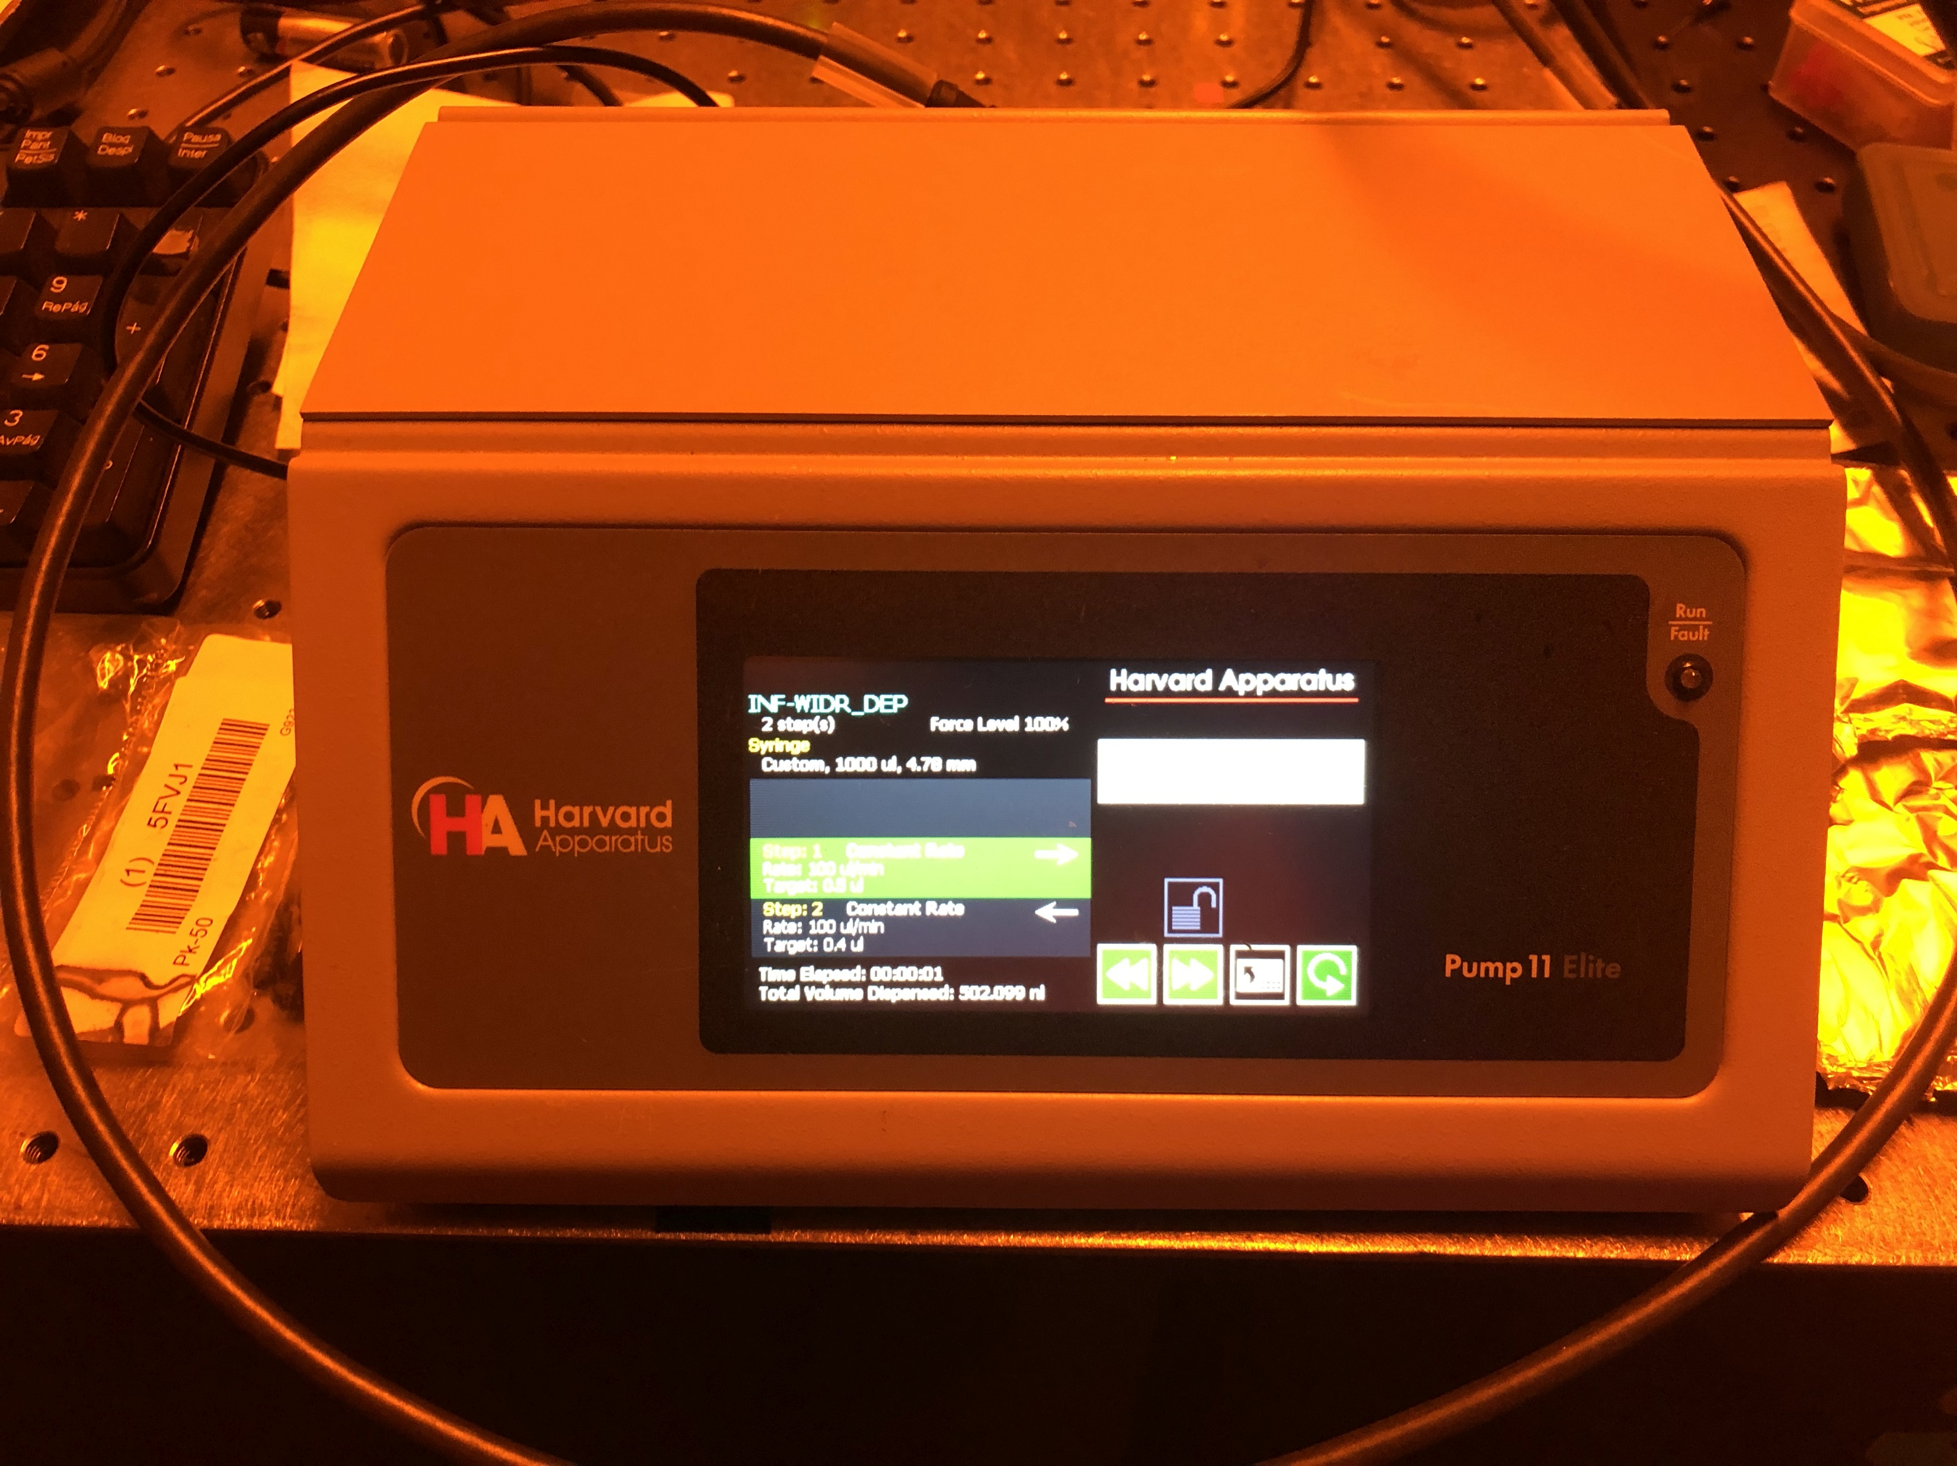

Slide 25
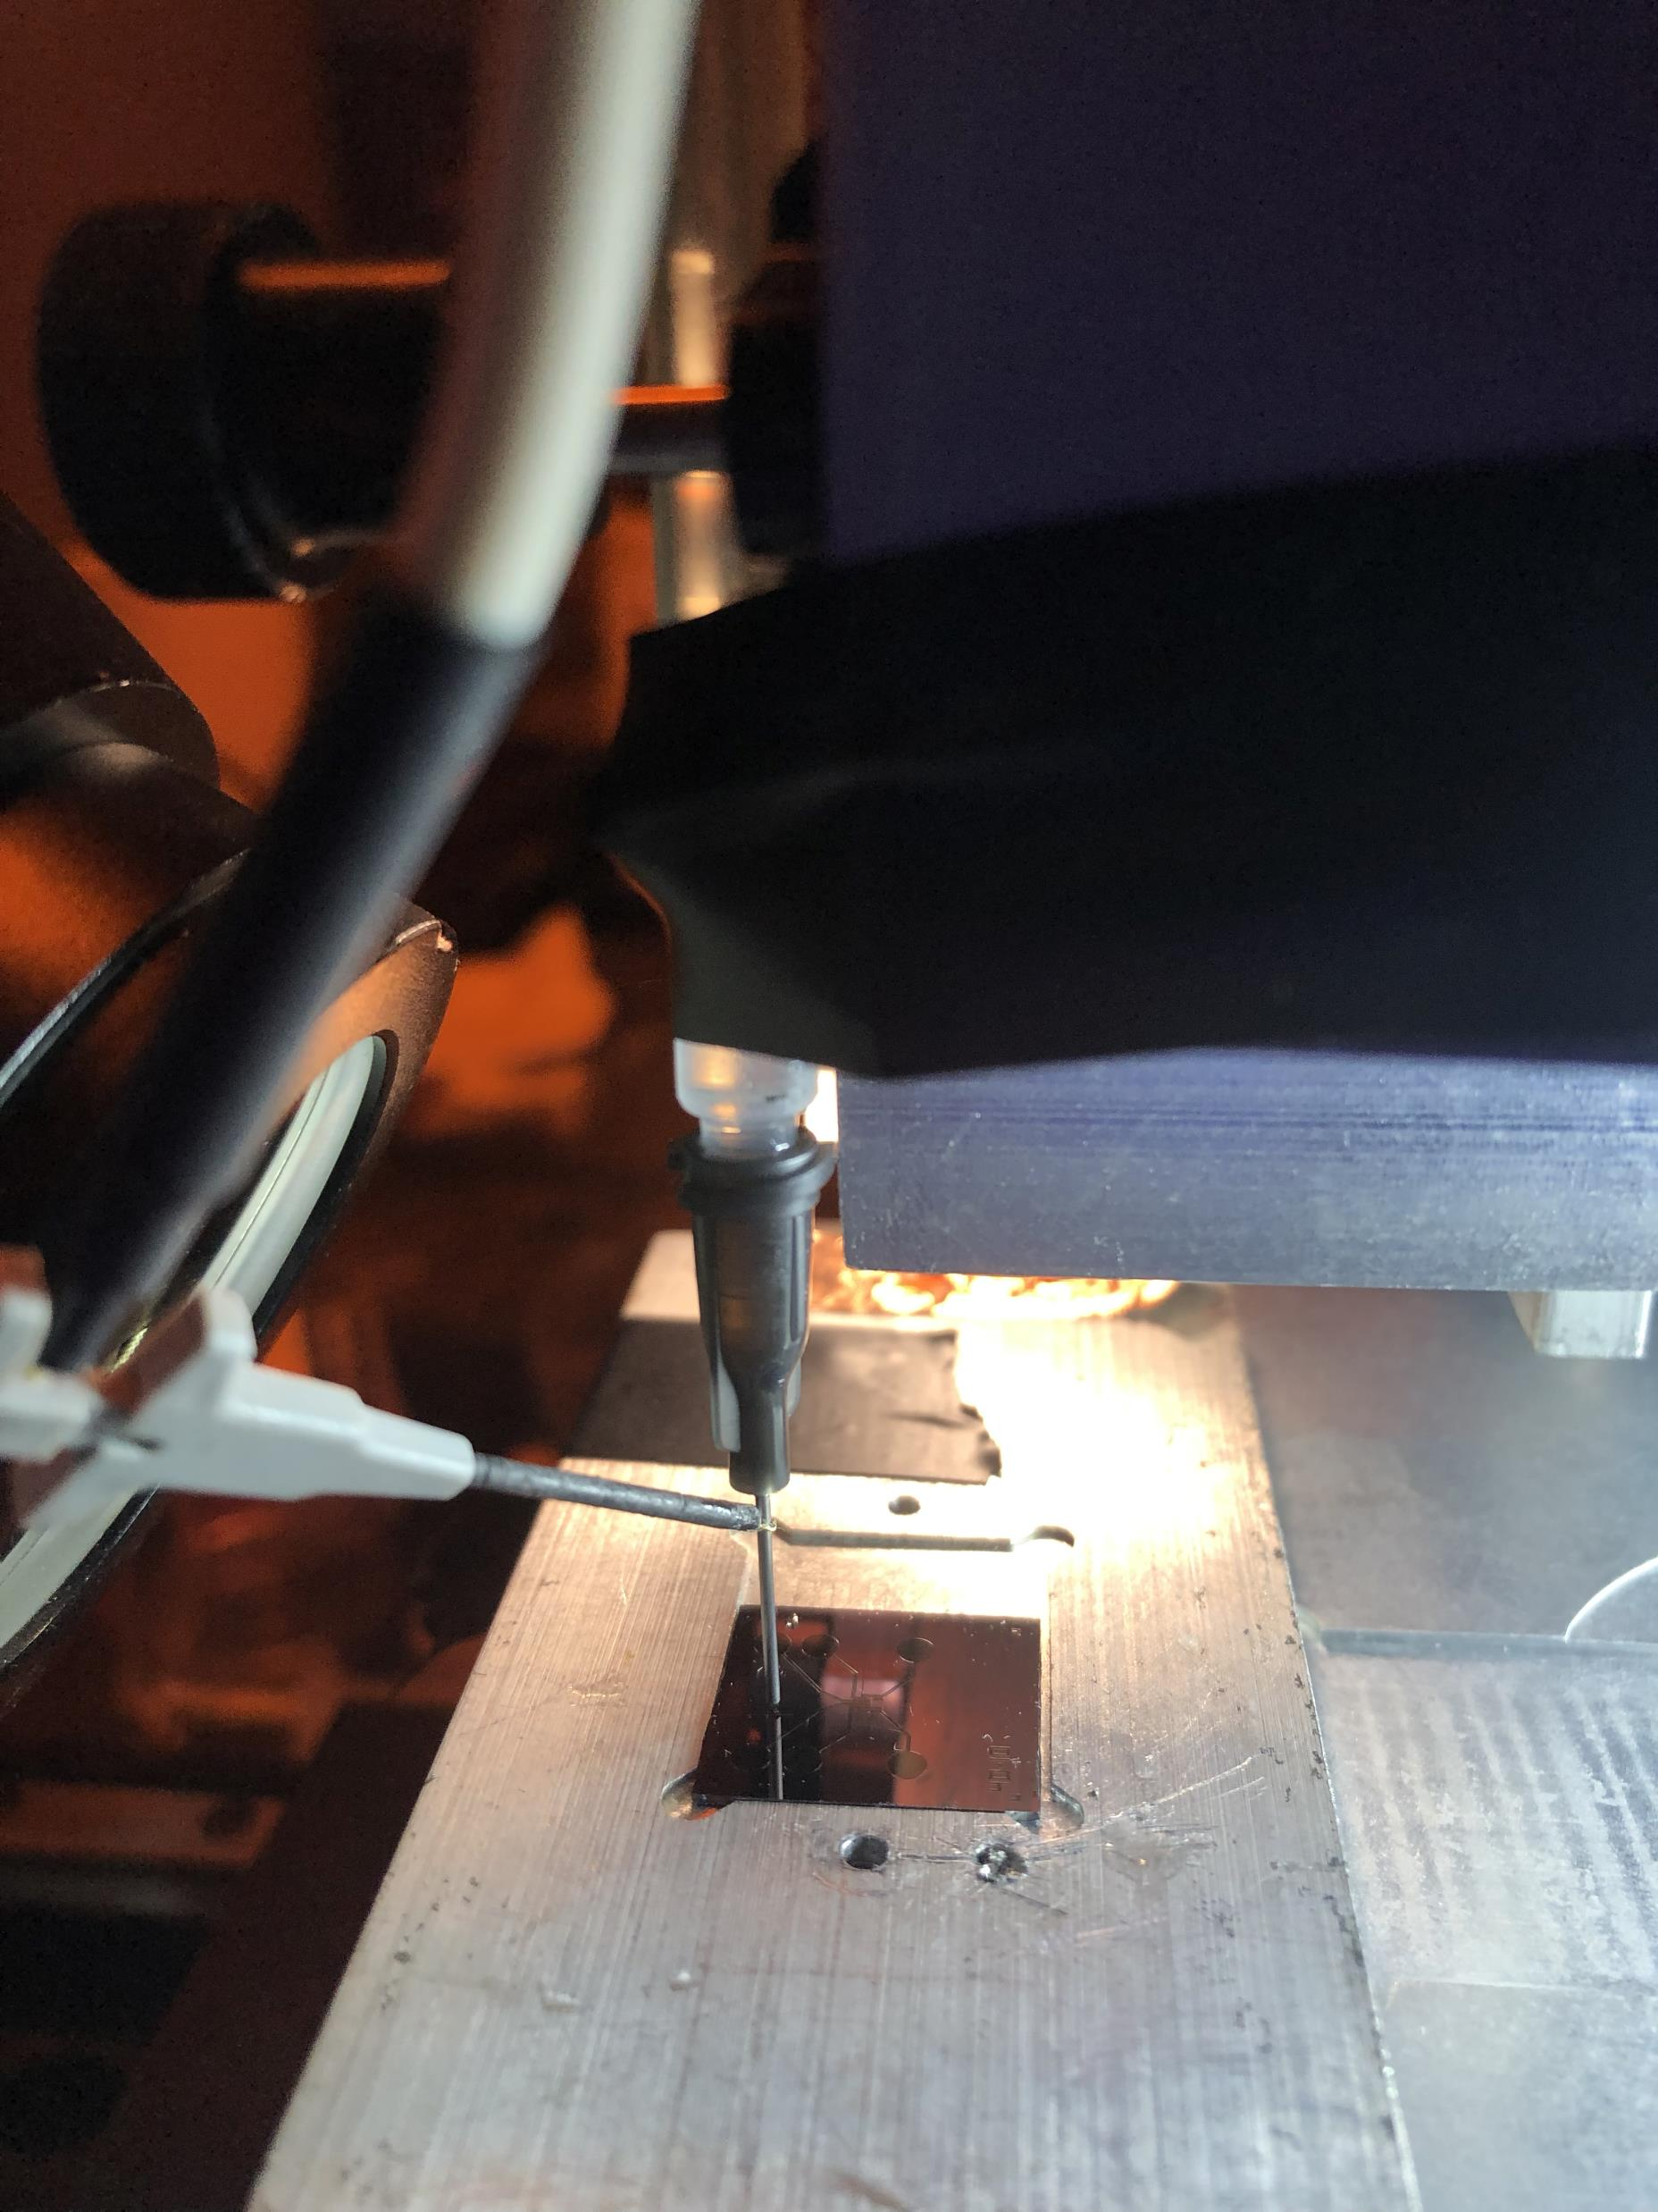
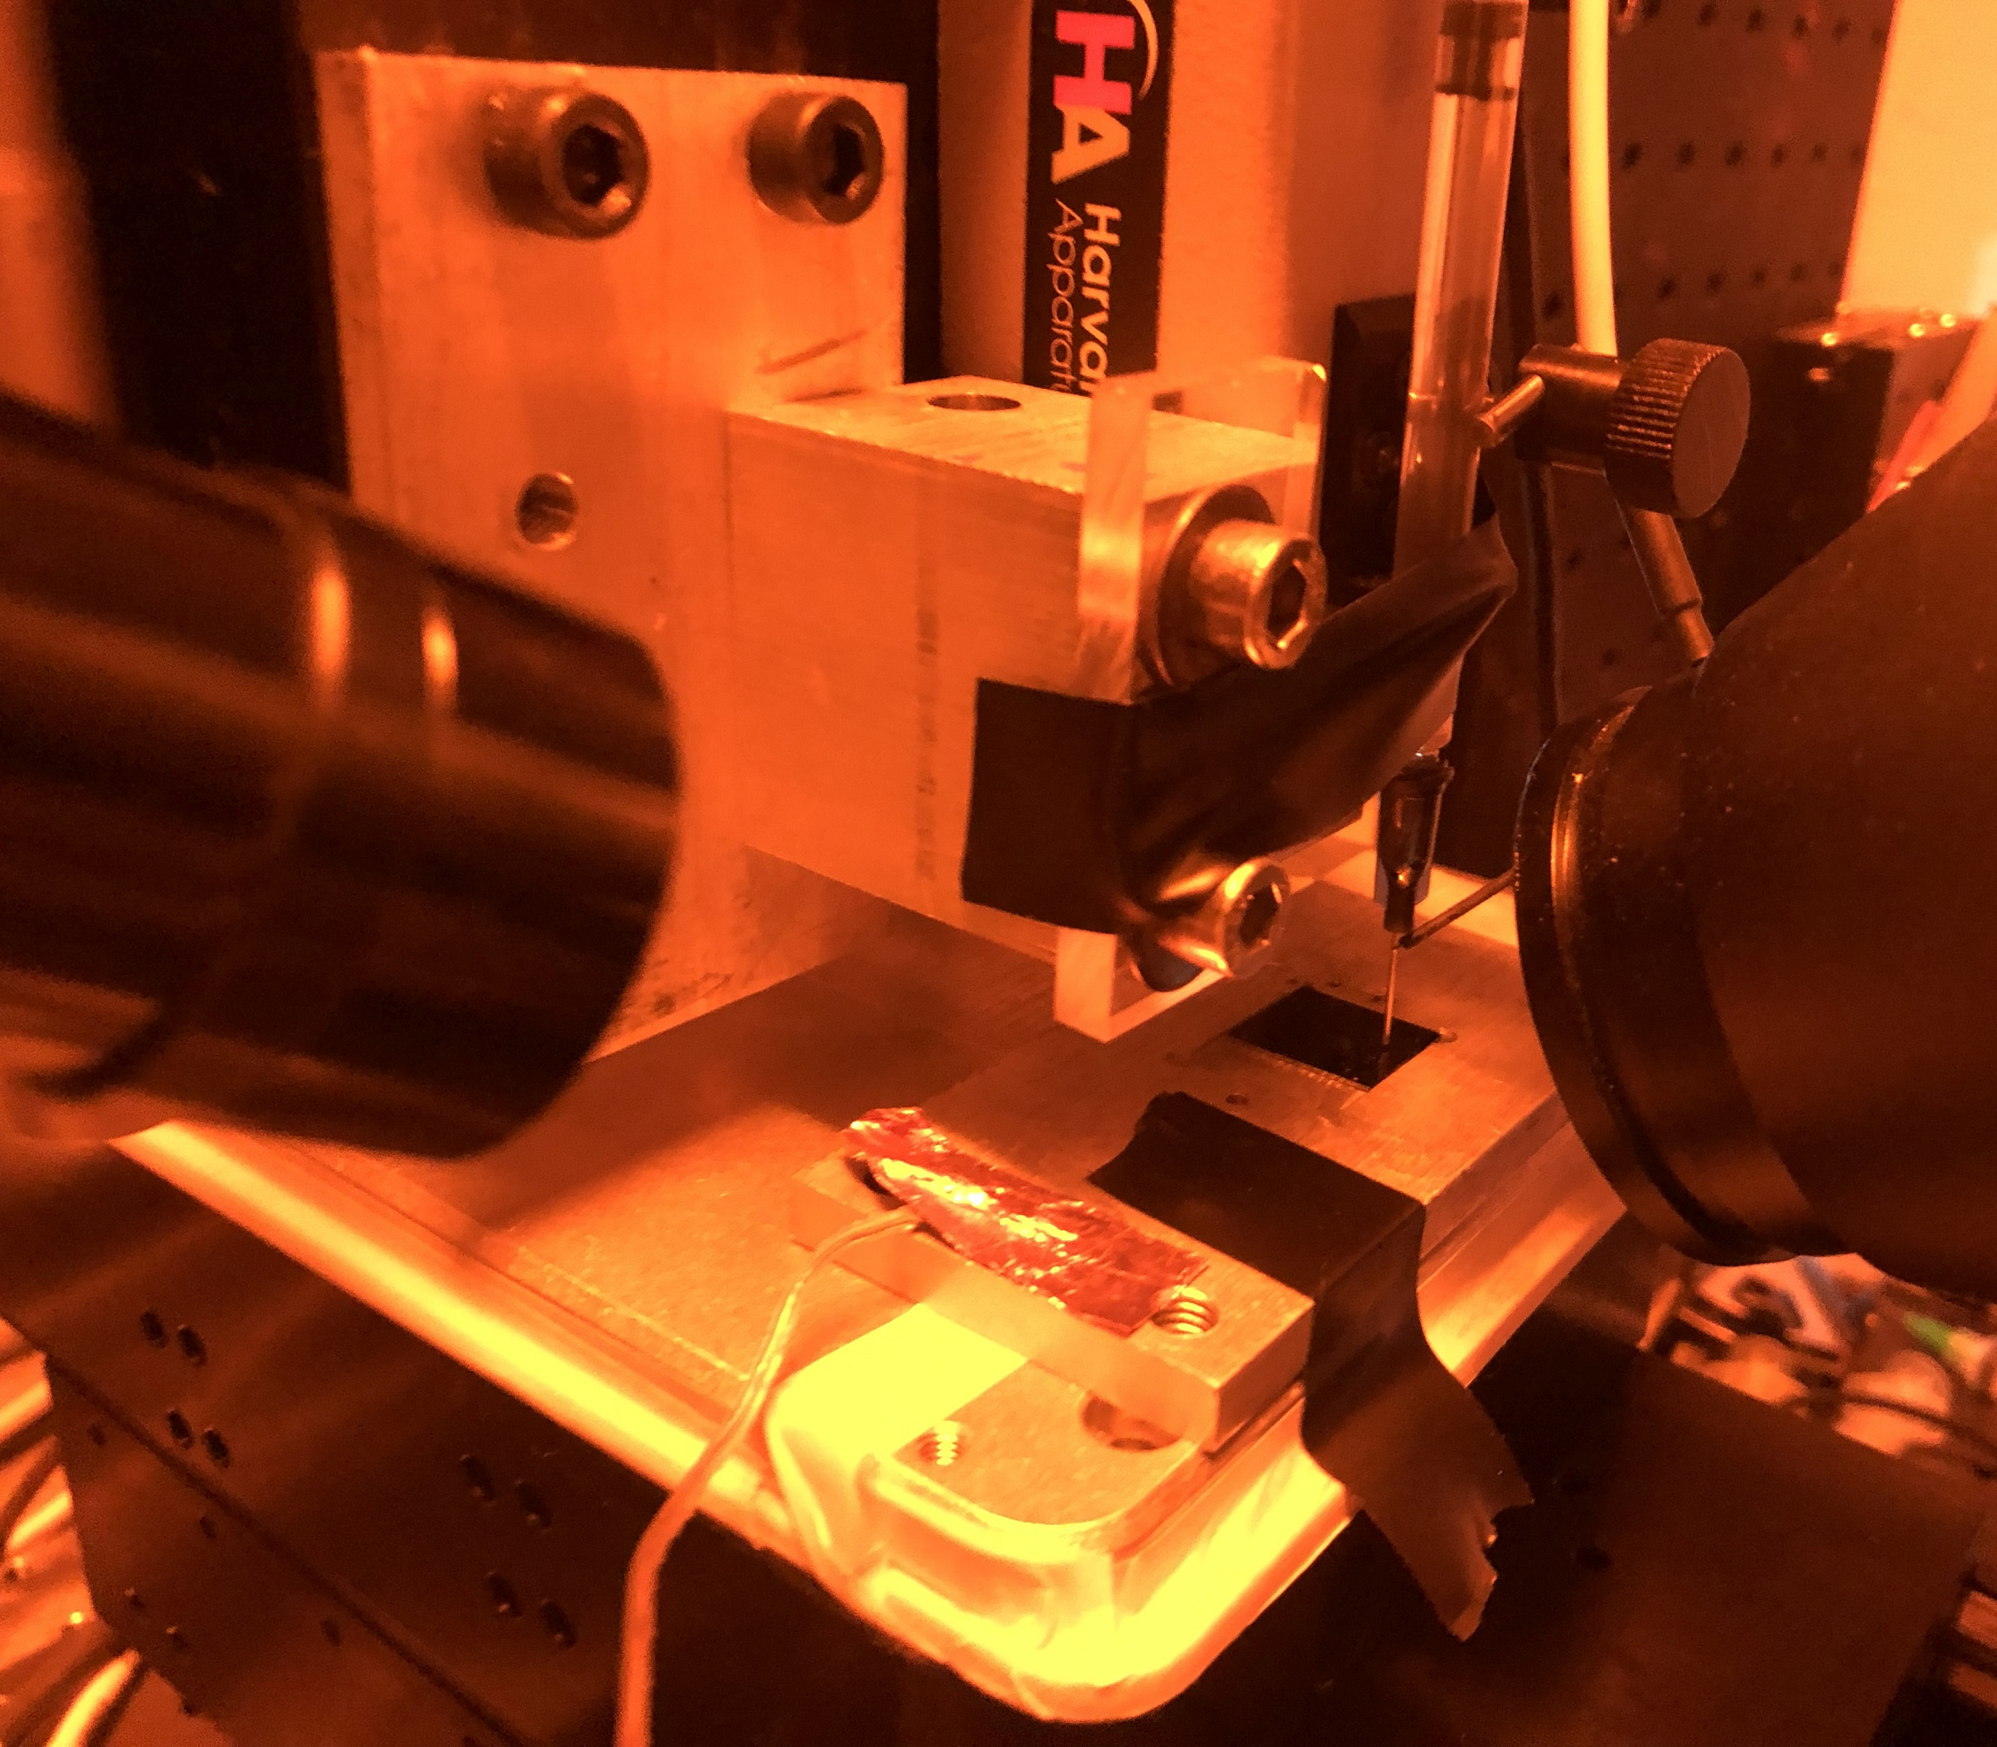

Slide 26
PEO Solution
The EMS polymer solution consisted of
2ml of SU-8 2002 mixed with
0.5 wt% of Poly(ethylene oxide) (PEO, 4,000,000 MW; SigmaAldrich Inc., Cat. N. 189464) and
0.5 wt% Tetrabutylammonium Tetrafluoroborate salts (TBATFB; SigmaAldrich Inc., Cat. N. 217964) to increase its conductivity and allow smooth polymer flow during electrospinning.
All reagents were used as received. Magnetic stirring of these components was performed for 1hr at 75°C and low rpm (100-150 rpm).

Slide 27
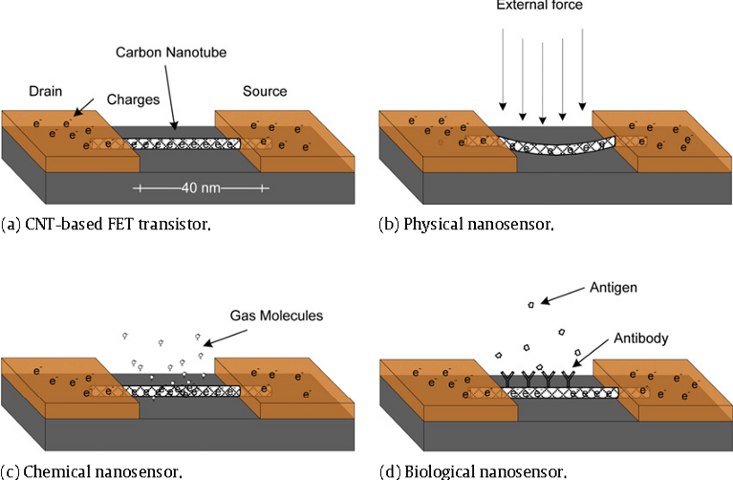
Applications of CNWs

Slide 28
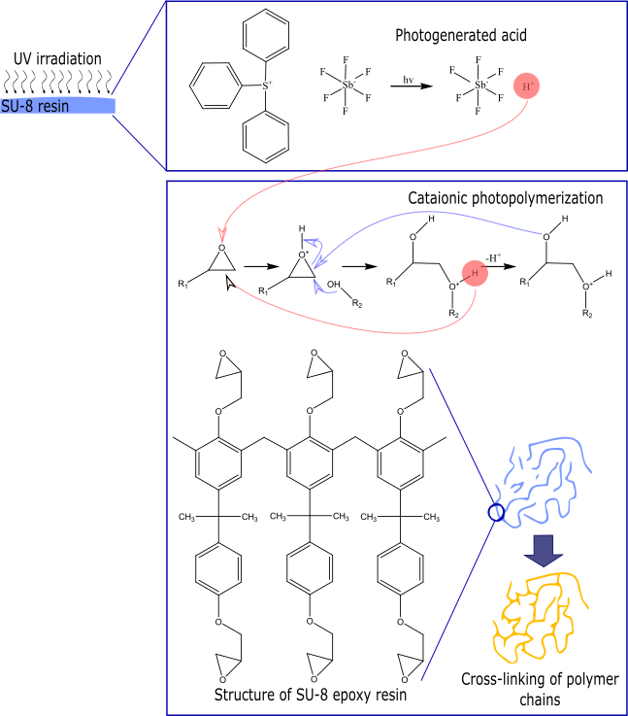
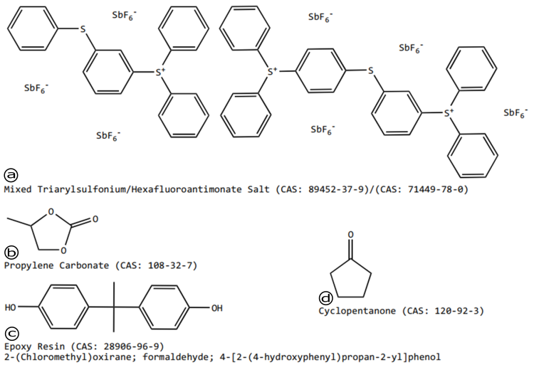
SU-8 (MicroChem,US)
Notes:
https://rsc.aux.eng.ufl.edu/_files/msds/309.pdf

Slide 29
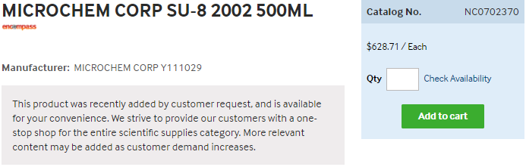
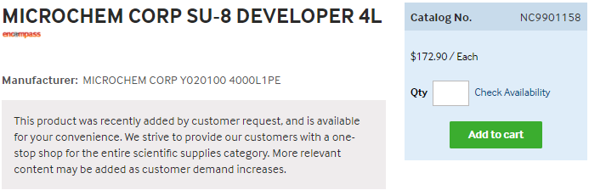
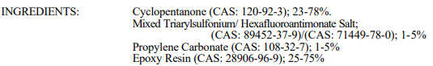
SU-8 (MicroChem, US)
https://www.fishersci.com/shop/products/NC9901158/nc9901158#?keyword=SU-8++developer
https://www.fishersci.com/shop/products/NC0702370/nc0702370#?keyword=MICROCHEM+CORP+PHOTORESIST+SU-8
Notes:
https://rsc.aux.eng.ufl.edu/_files/msds/309.pdf

Slide 30
<subTitle>
<content> <key concept>

